Slide 1
LAB 0: GETTING STARTED WITH TABLEAU
September 15, 2016
SDS 136
Communicating with Data

Slide 2

Announcements
TA Office Hours:
Thursday nights in Burton 209
Subashini: 4-6pm
Grace: 6:30-8pm
Loaner laptops should be in shortly ☺

Slide 3
Outline
Finish up lecture from Tuesday
Introduction to Tableau
Lab pt. 1 - Getting started:
Connecting to a data file
Creating views
Using “Show Me”: a recommender system for views
Lab pt. 2 - Exploring other datasets
Discussion (time permitting)
Lab pt. 1 modeled on “Getting Started with Tableau Desktop” Version 8.2
Last Updated June 11, 2014 3:09 PM Copyright © 2014 Tableau Software

Slide 4

Flashback: Visualization (def.)
Visual representations of data that reinforce human cognition
Notes:
Image from StackOverflow: http://i.stack.imgur.com/hbO8v.jpg

Slide 5

Graphical primitives
The images we draw are composed of marks: like ink
Lines
Points
Areas

Slide 6
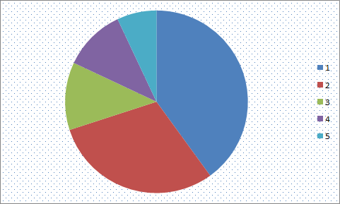
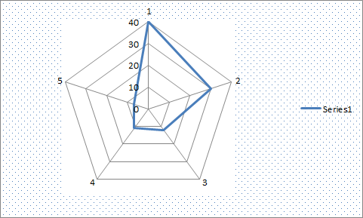
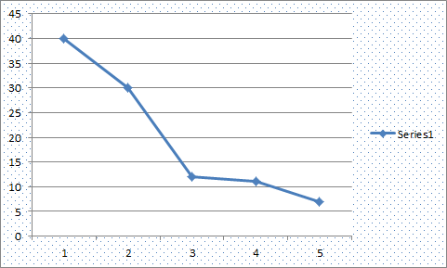
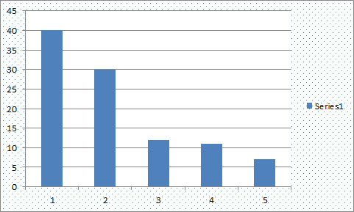
Key question for this course
Which data dimension should be mapped
to which visual dimension?

Slide 7
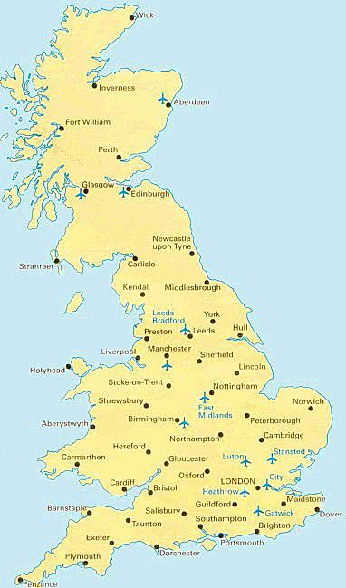
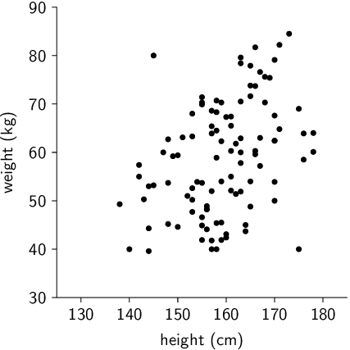
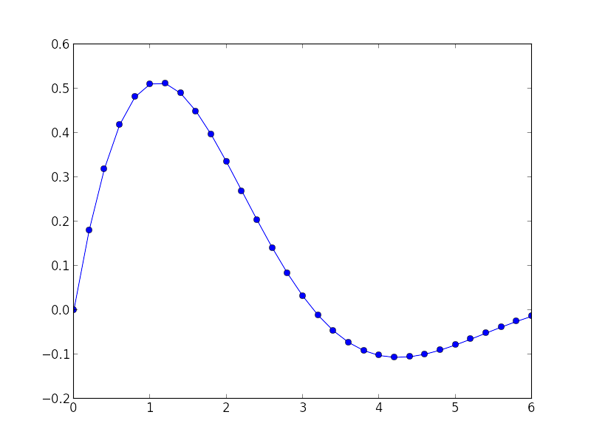
Visual dimension: position
Encode information using where the mark is drawn
Some examples:

Slide 8
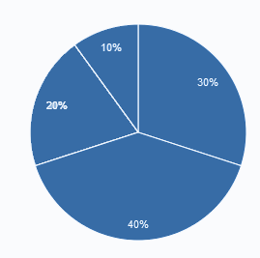
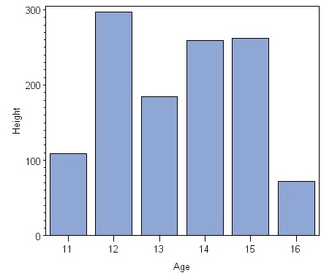
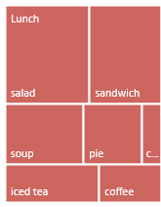
Visual dimension: size
Encode information using how big the mark is drawn
Examples:

Slide 9
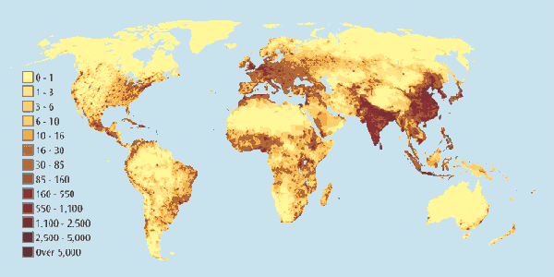
Visual dimension: value
Encode information using how dark the mark is drawn
Example:

Slide 10
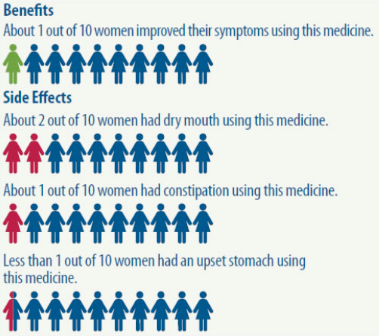
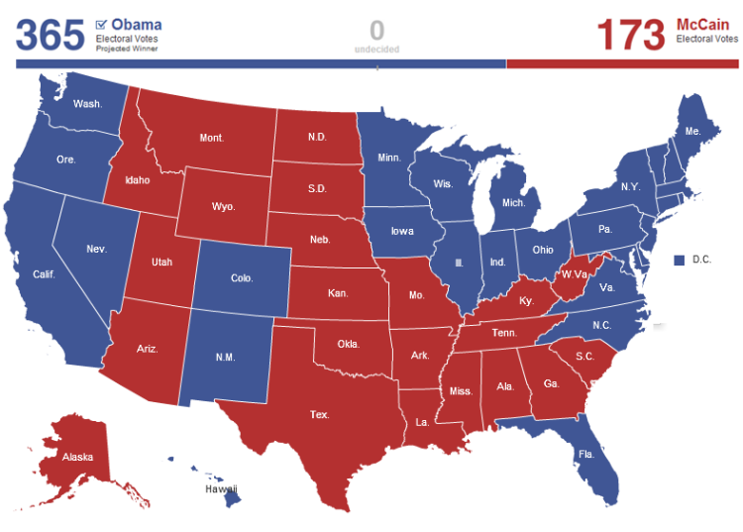
Visual dimension: color
Encode information using the hue of the mark
Examples:

Slide 11
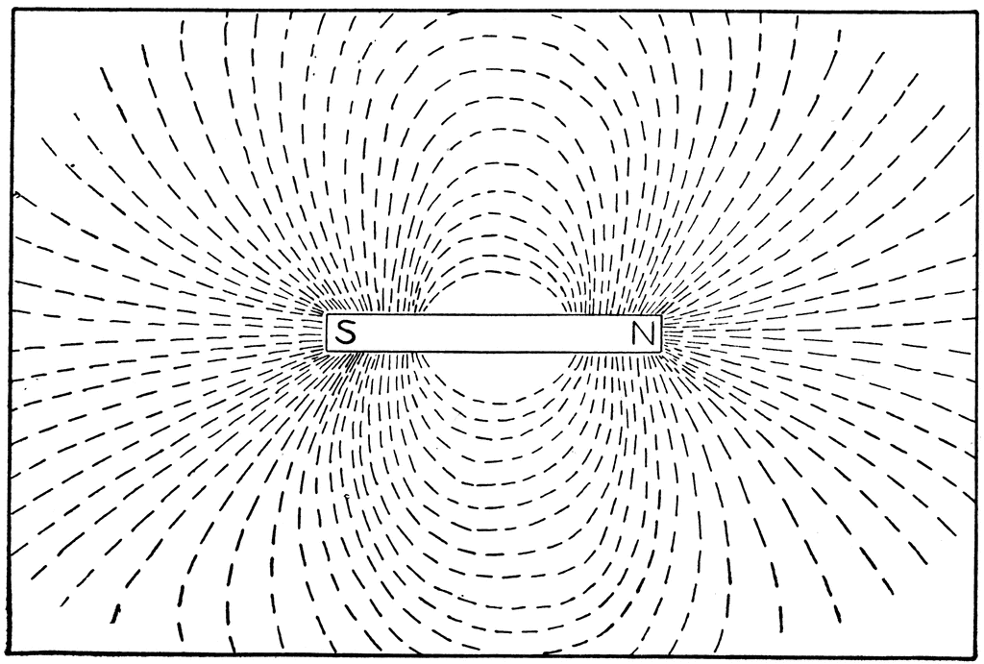
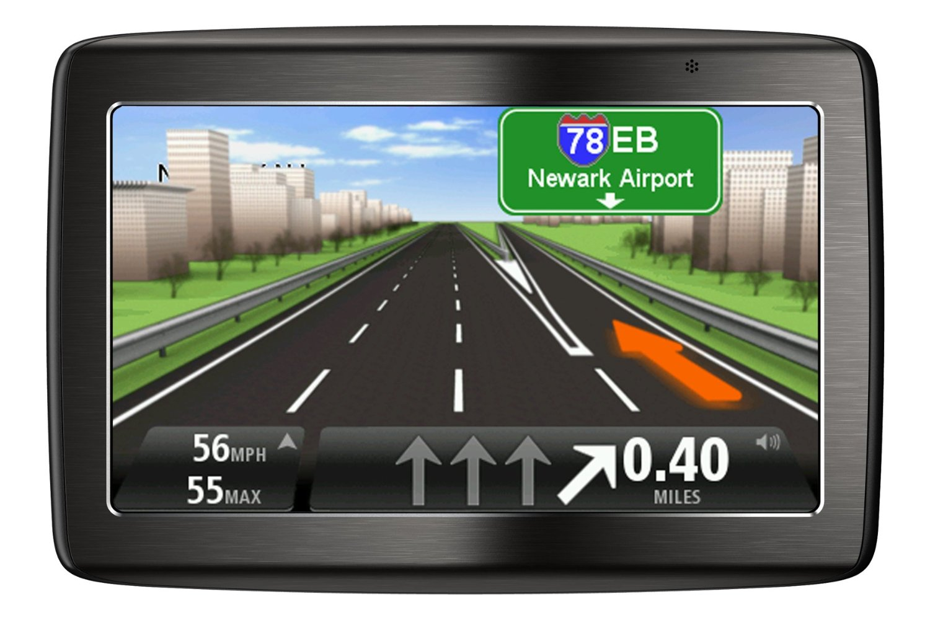
Visual dimension: orientation
Encode information using how the mark is rotated
Examples:

Slide 12


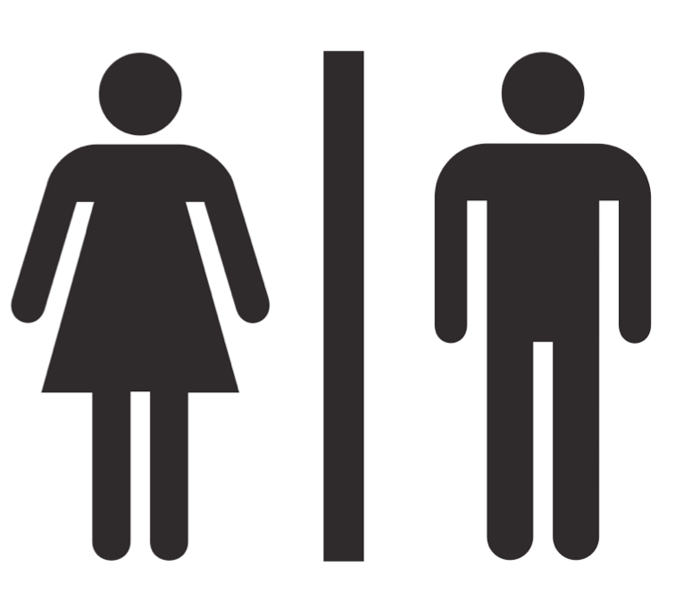
Visual dimension: shape
Encode information using how the mark is shaped
Examples:

Slide 13
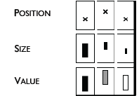
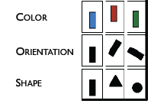

Discussion: visual dimensions & data type
Nominal Ordinal Quantitative
Jacques Bertin, Semiologie Graphique (Semiology of Graphics), 1967.

Slide 14
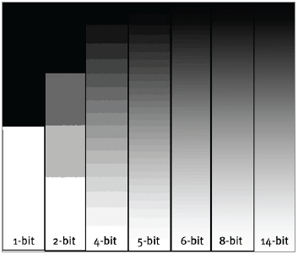
Continuous vs. discrete: value
Slide courtesy of Sara Su

Slide 15
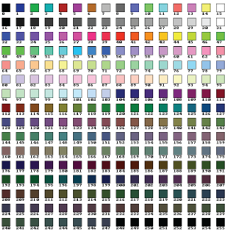
Continuous vs. discrete: color
Slide courtesy of Sara Su

Slide 16

Introduction to Tableau
A drag-and-drop tool for mapping data dimensions onto visual dimensions
Today we will learn:
How to load data into Tableau
A little bit about how Tableau organizes data
How to tell Tableau which facets of the data to display, and how

Slide 17




What is ?
Visualization and business analytics software with a strong focus on relational data
Idea originally developed at Stanford University
Now a publically traded company based in Seattle, WA with 2400 employees, $412 million in revenue (2014)
Image credit: www.tableau.com/about/leadership

Slide 18
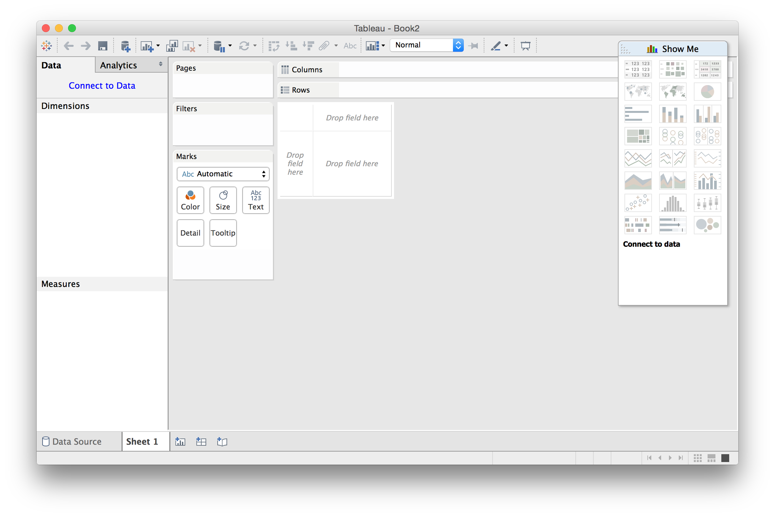
Main Window: New Workbook

Slide 19
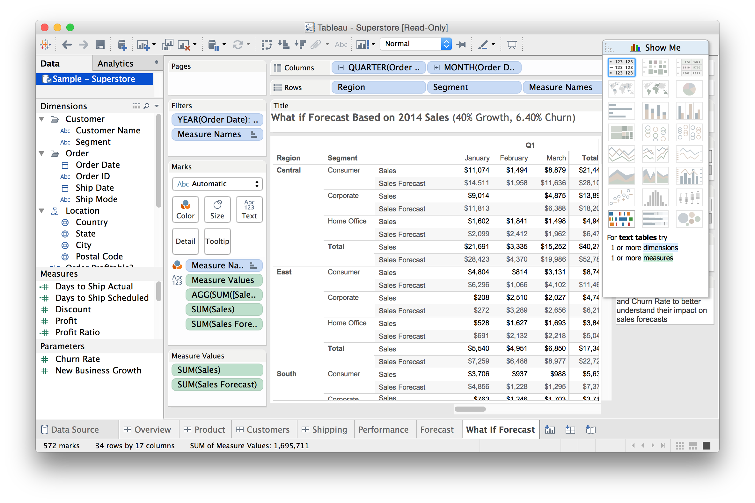
Main Window: with Data and Views

Slide 20
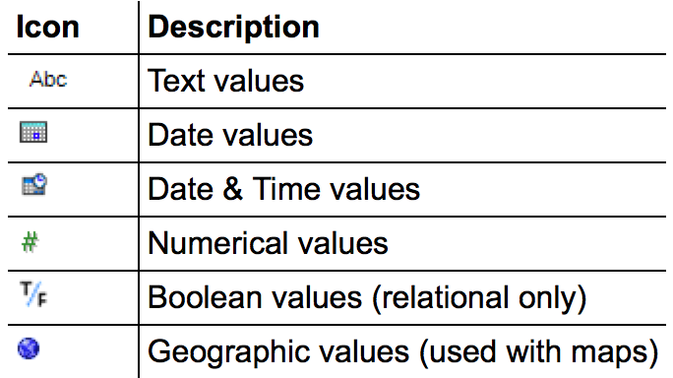
Data Types
All data fields are assigned one of the following types:
Occasionally the auto-detected type is wrong; this can be manually overridden using the menu

Slide 21
Main Window: with Data and Views

Slide 22
Data Roles: Dimensions
In general, any field containing qualitative or categorical information is treated as a dimension (e.g. text, dates)
In relational data, dimensions are the independent variables
Data can be aggregated using the values of a dimension
When added as rows/columns, dimensions produce headers

Slide 23
Data Roles: Measures
In general, any field containing quantitative information is treated as a measure (e.g. numerical data, etc.)
In relational data, measures are the dependent variables
The values of a measure are a function of one or more dimensions
When added as rows/columns, measures produce axes

Slide 24

Data Roles: Dimensions vs. Measures
measure
dimension
Which is which?
total number of students in each house
Which is which?
total number of students in each house
Which is which?
total number of students in each house

Slide 25
Main Window: with Data and Views

Slide 26
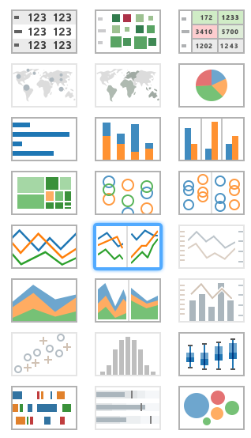
21 Available Views
Tables
Maps
Pie charts
Bar charts
Treemaps
Circle views
Line charts
Area charts
Combination charts
Scatterplots
Histograms
Box-and-whisker plots
Gantt
Bullet plots
Packed circles
Tables
Maps
Pie charts
Bar charts
Treemaps
Circle views
Line charts
Area charts
Combination charts
Scatterplots
Histograms
Box-and-whisker plots
Gantt
Bullet plots
Packed circles

Slide 27
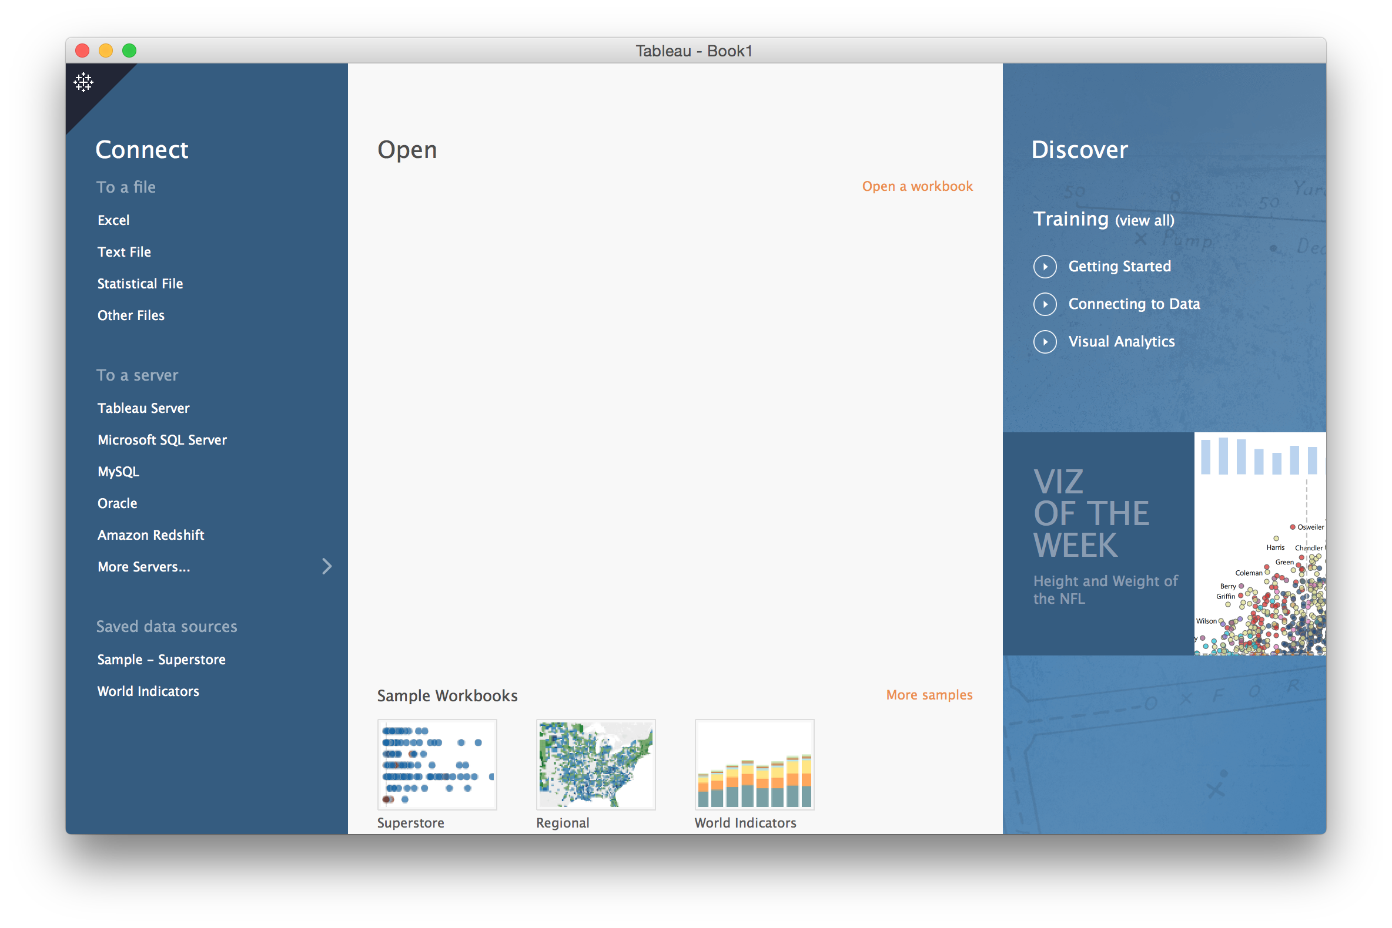
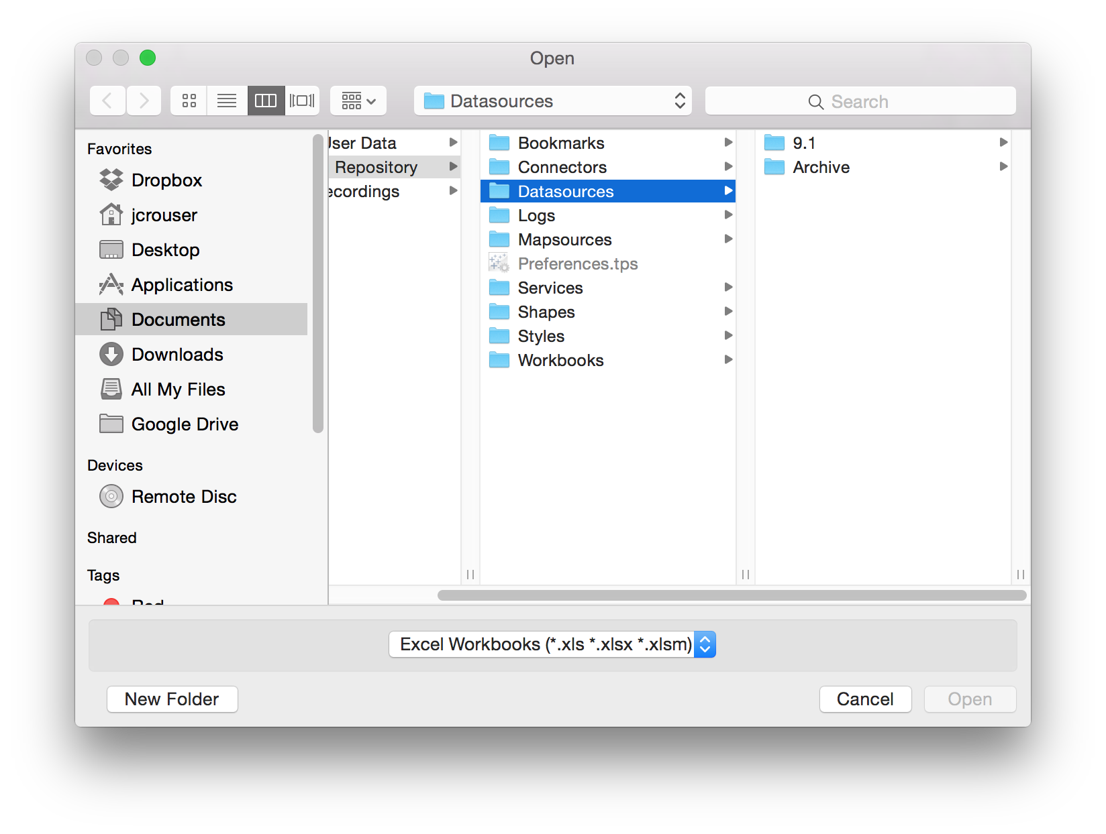
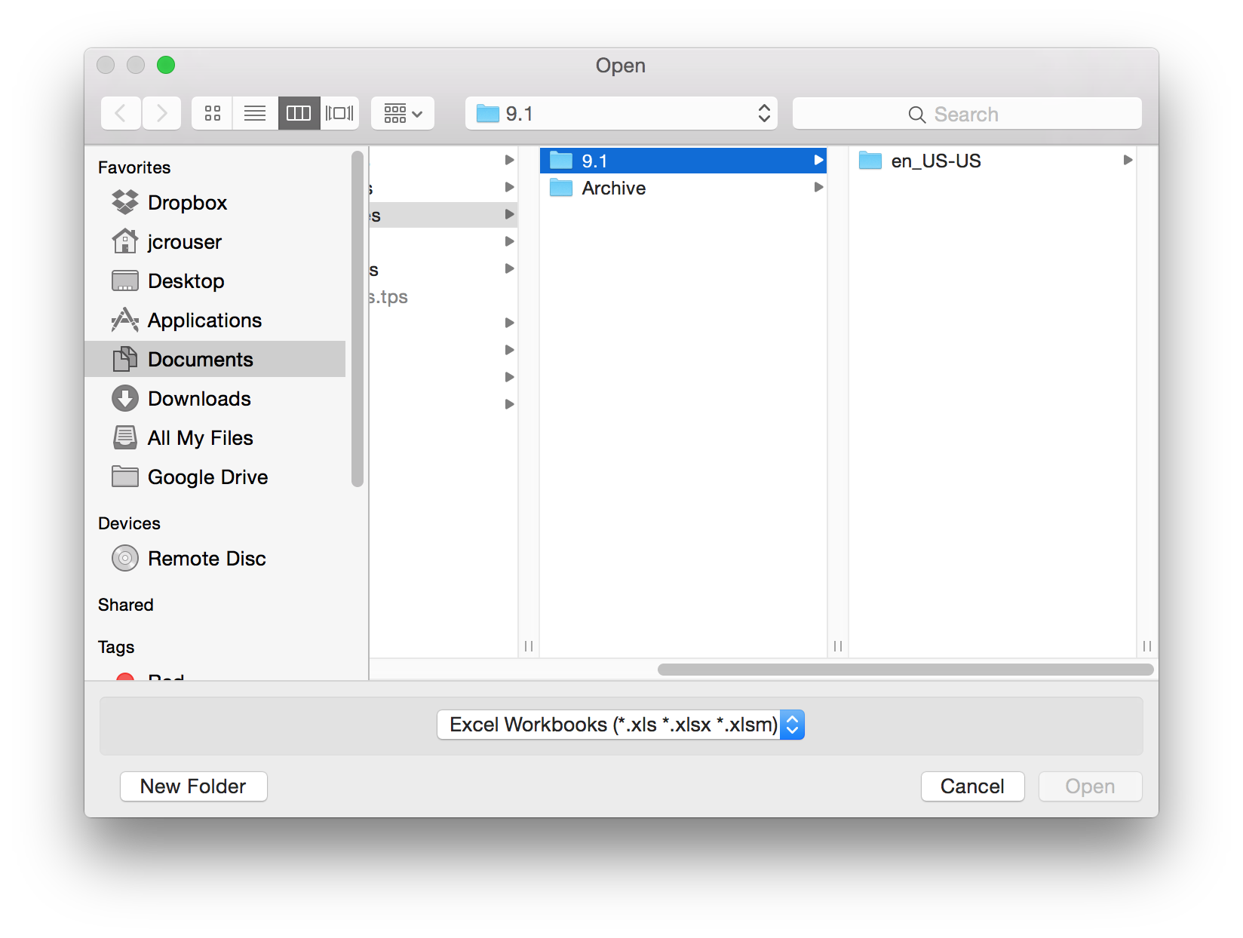
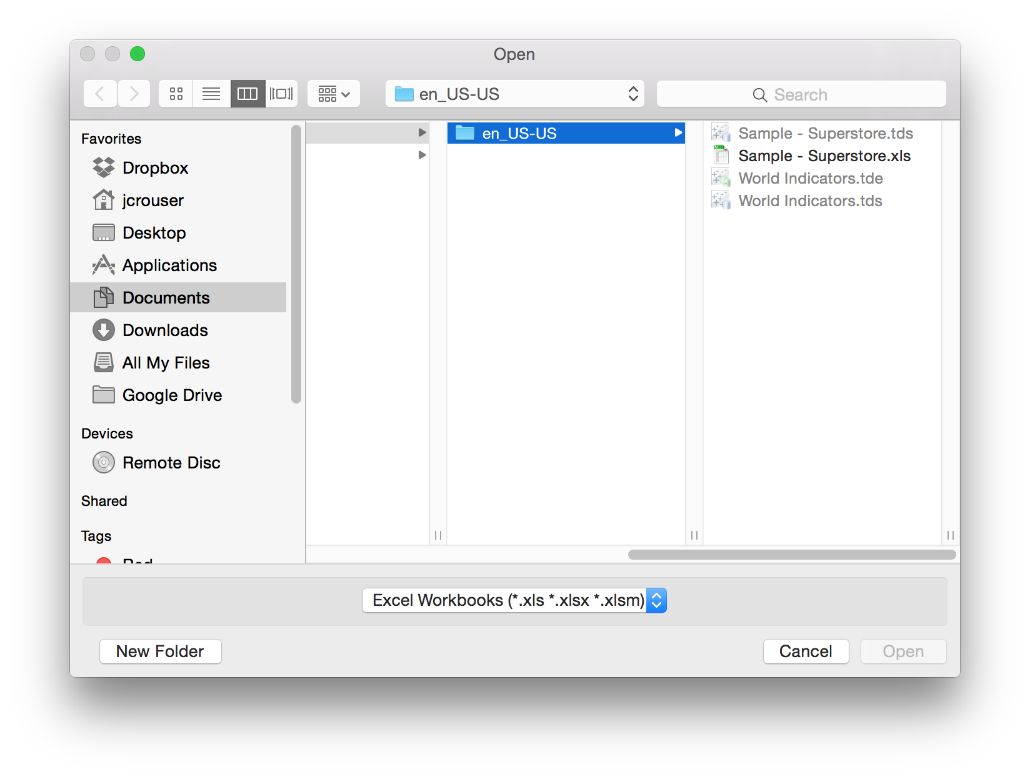
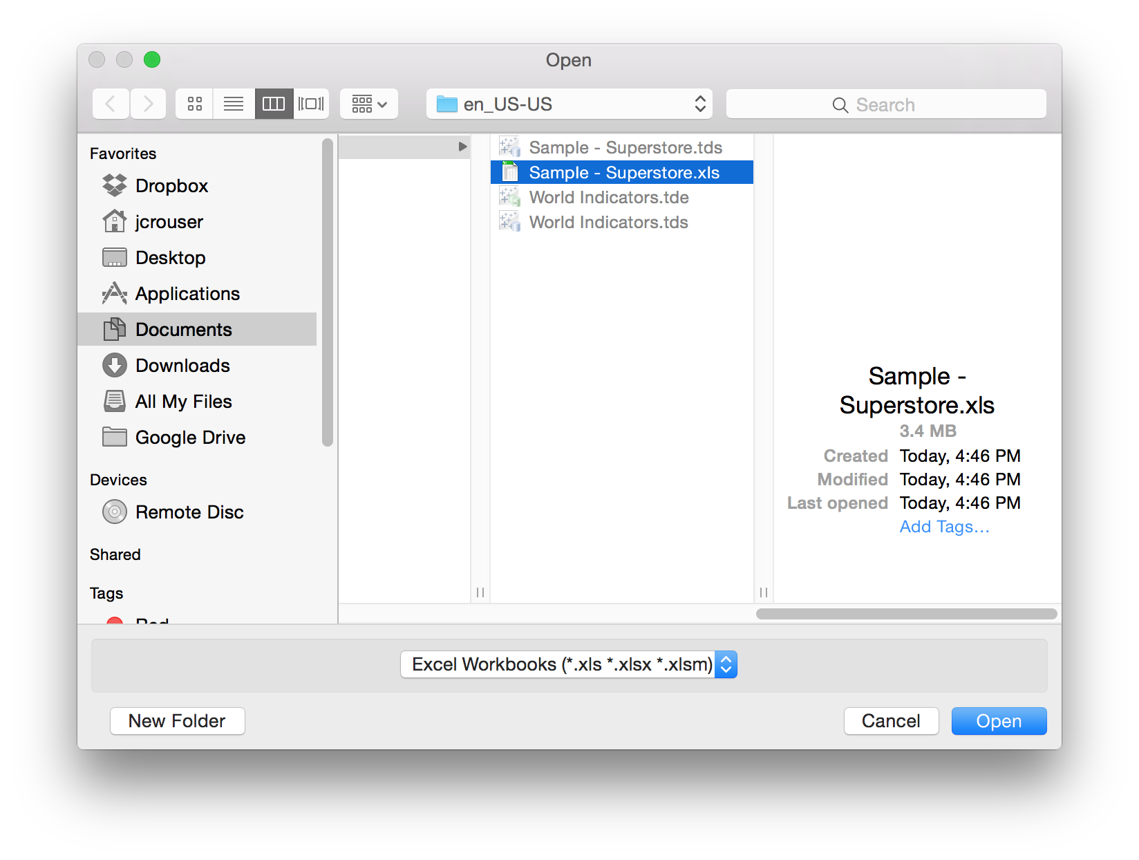
Lab pt. 1: Getting Started

Slide 28
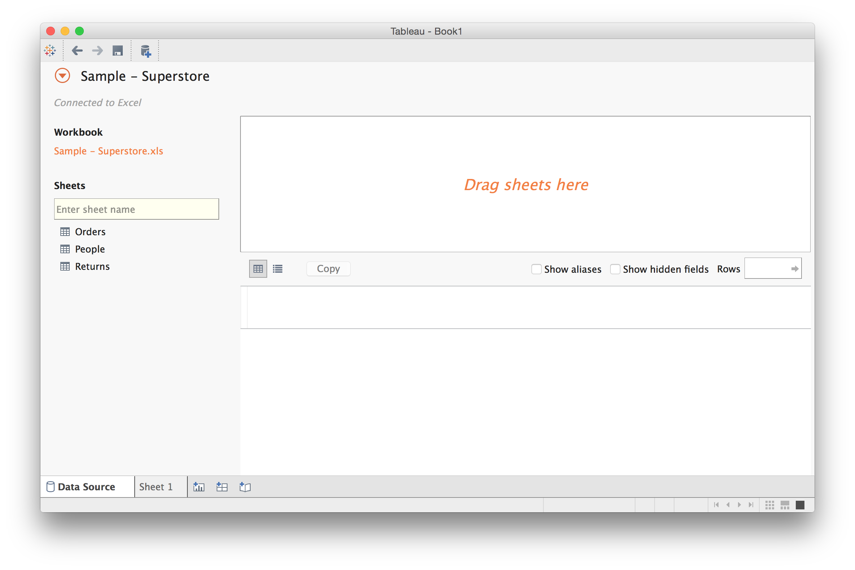
Connecting to a Data File

Slide 29
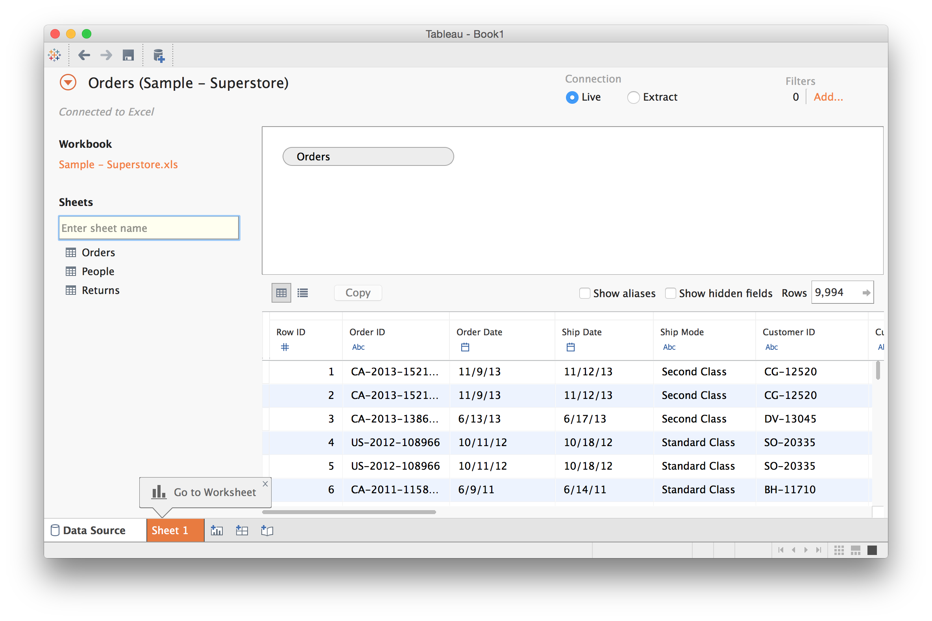
Connecting to a Data File

Slide 30
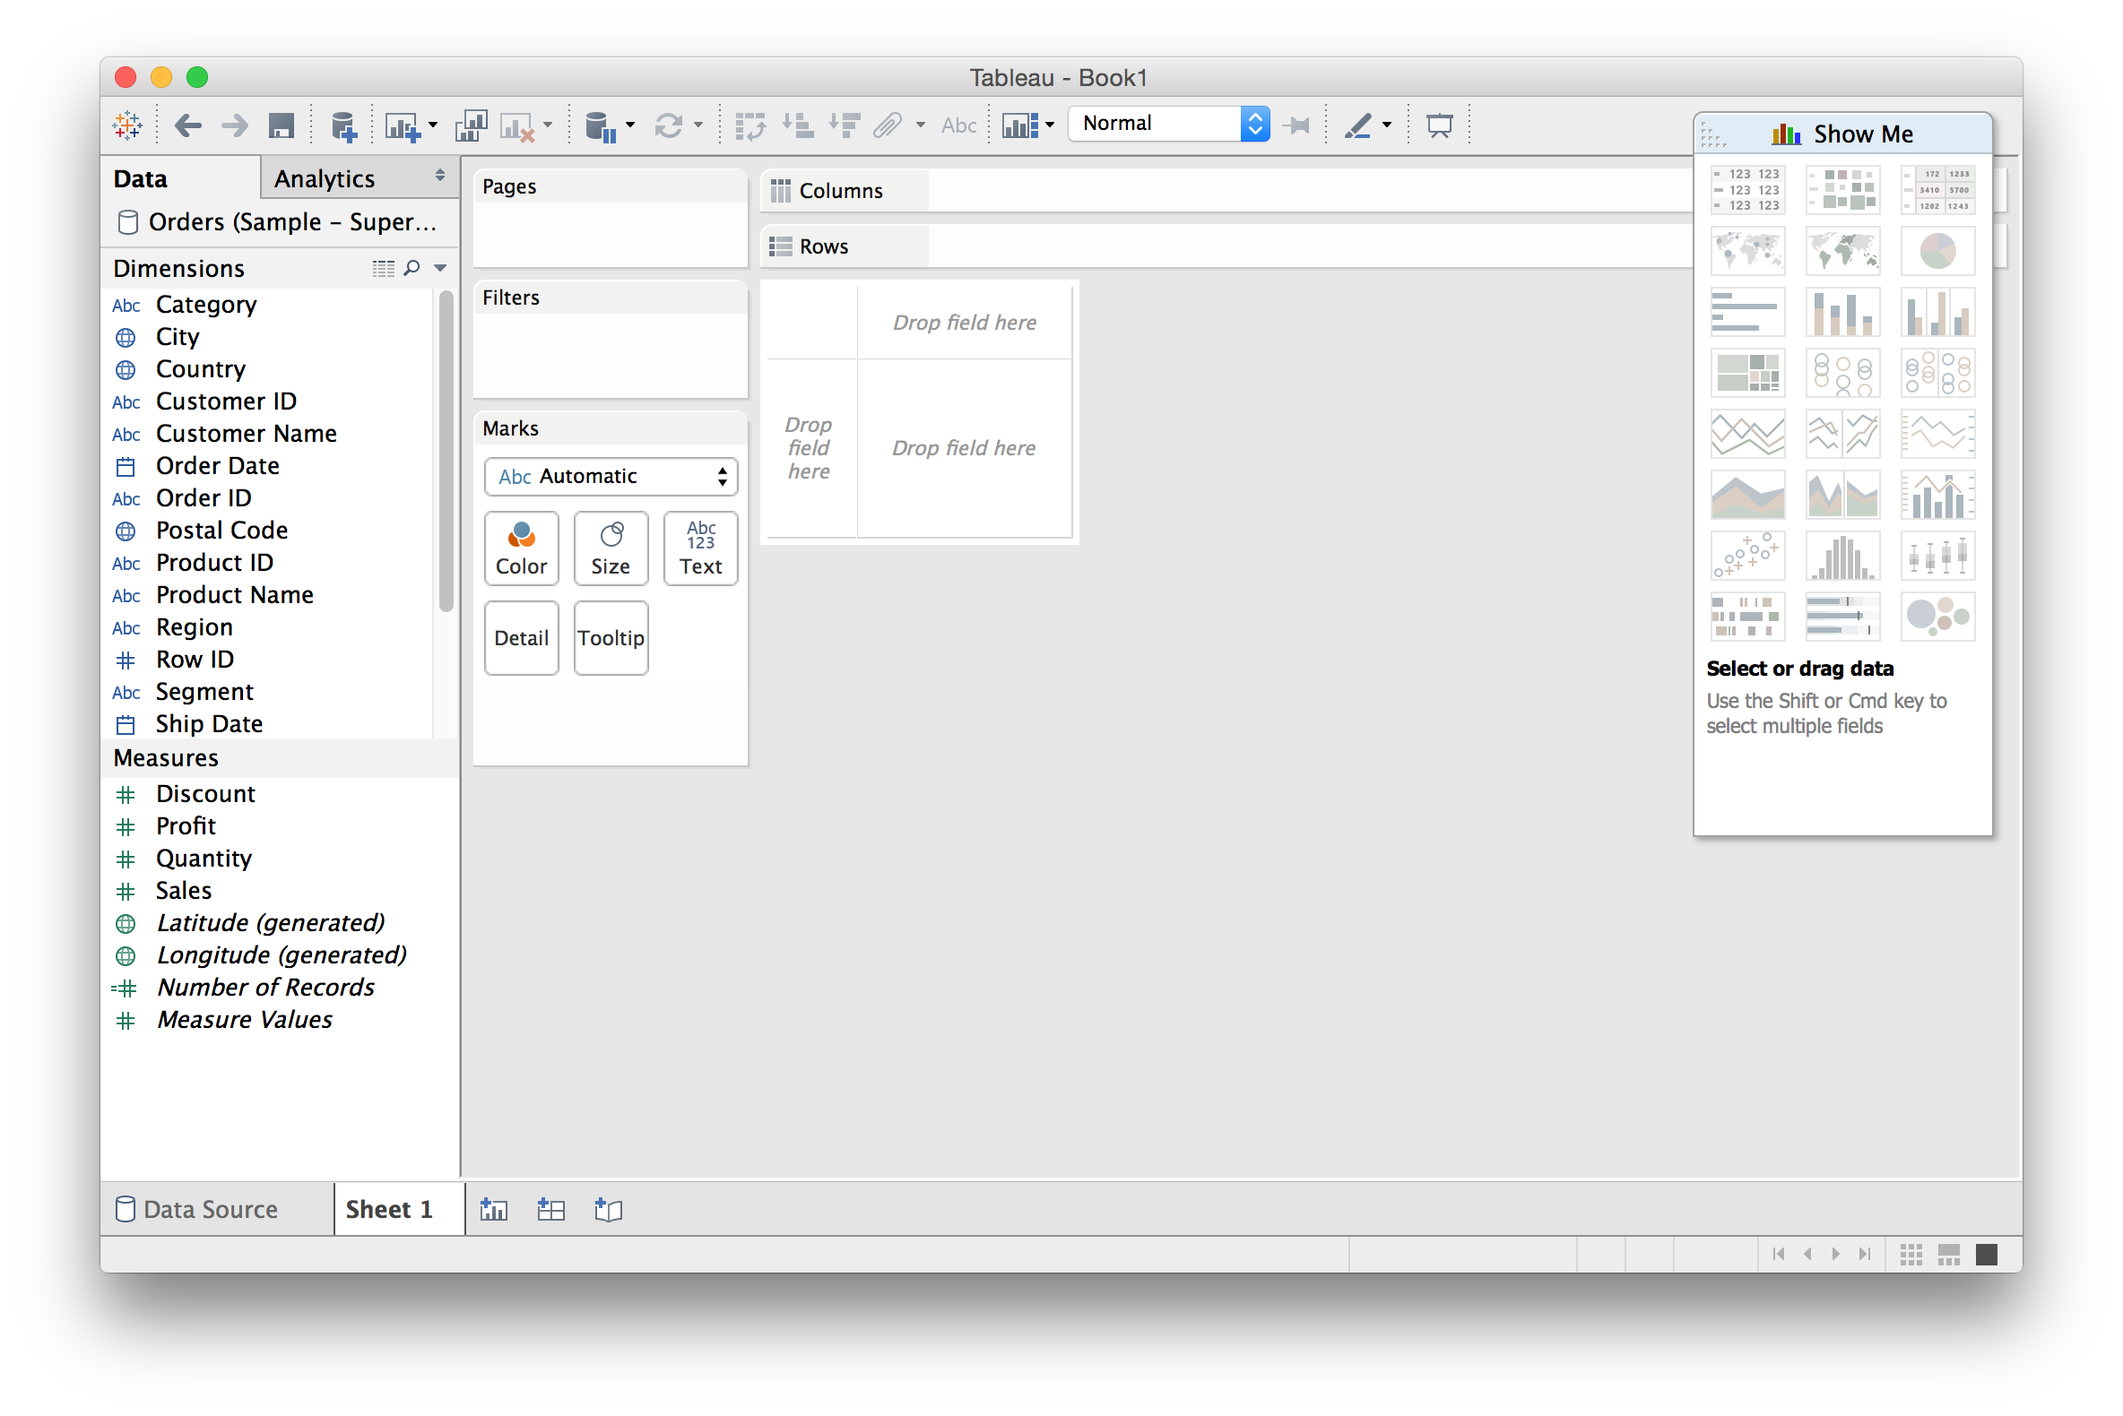
Creating Views

Slide 31
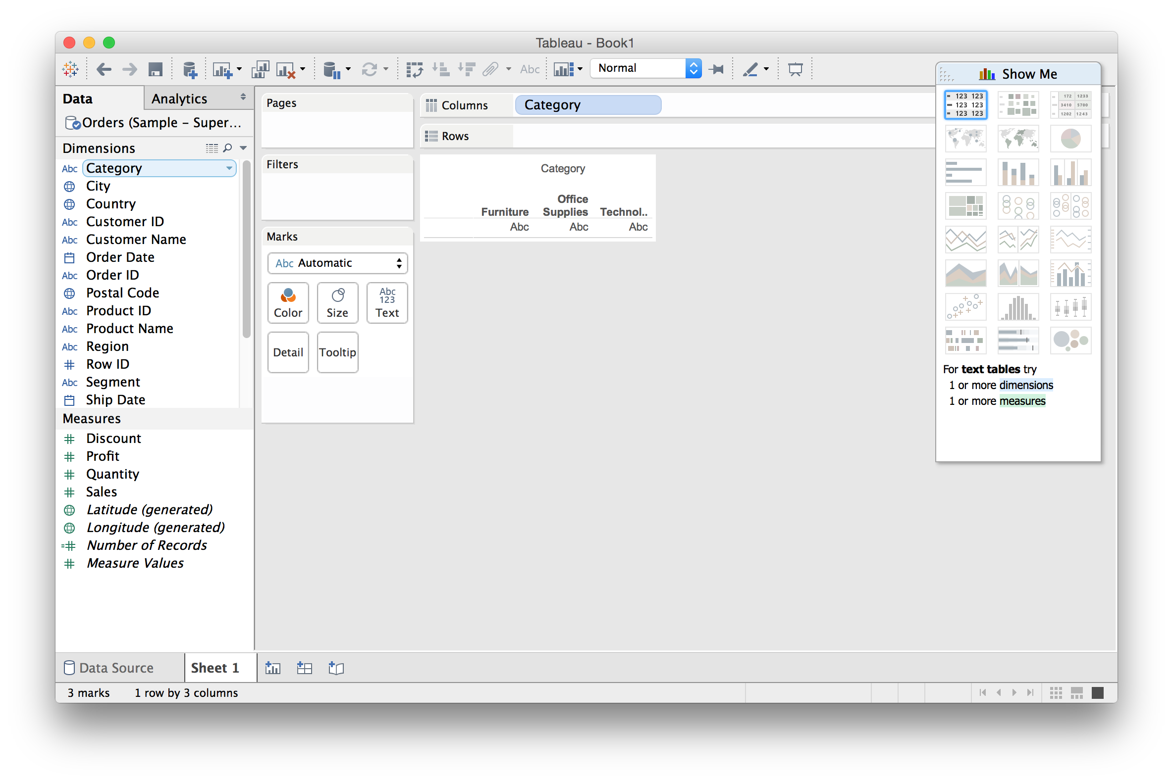
Drag a dimension to “Columns”

Slide 32
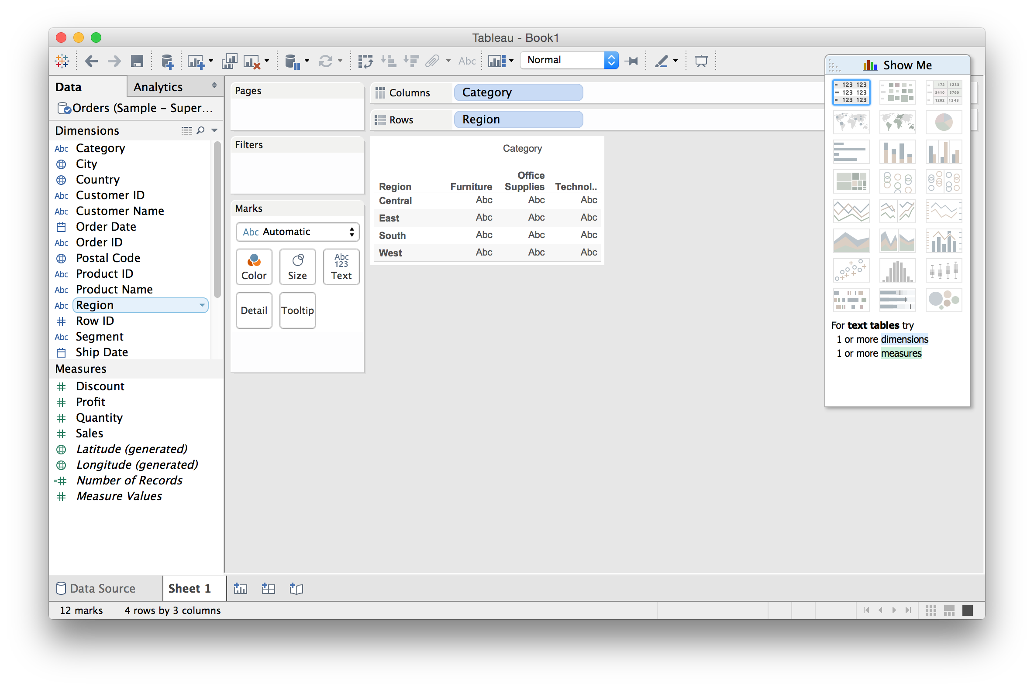
Drag a dimension to “Rows”

Slide 33
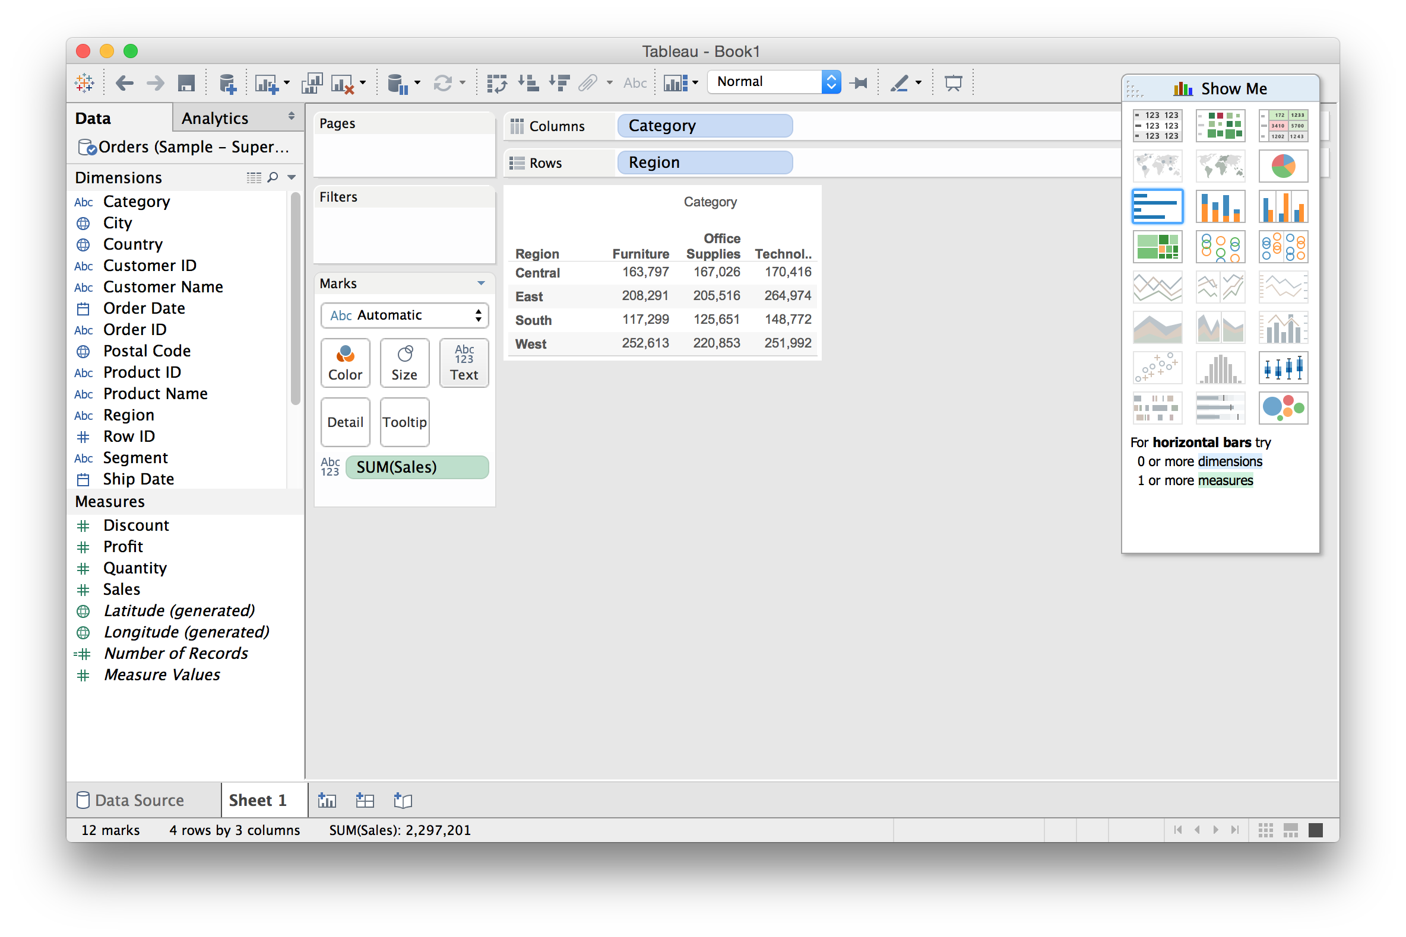
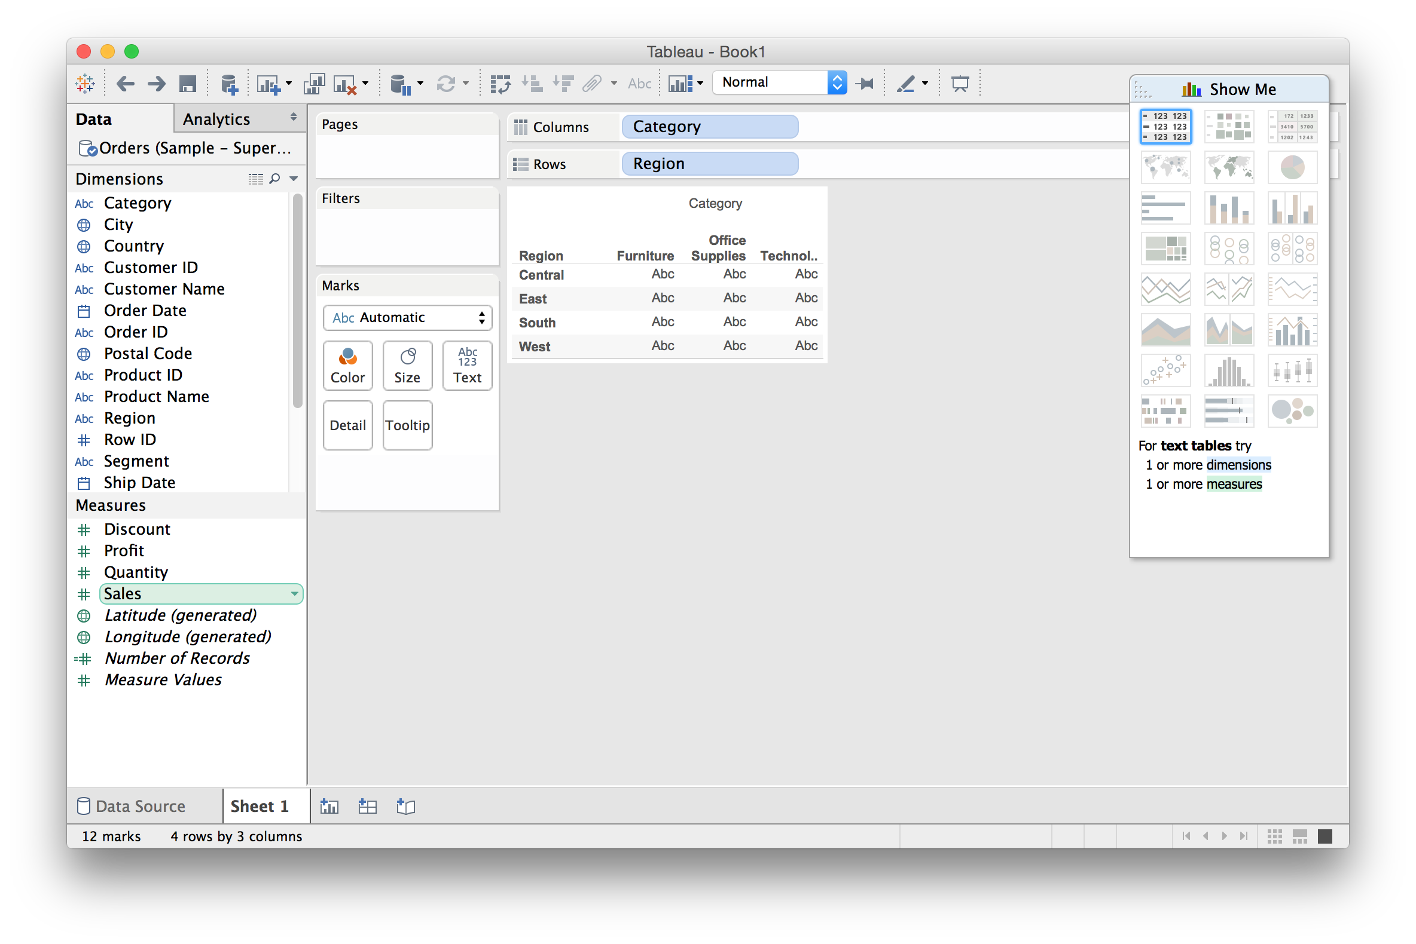
Drag a measure onto “Text”

Slide 34
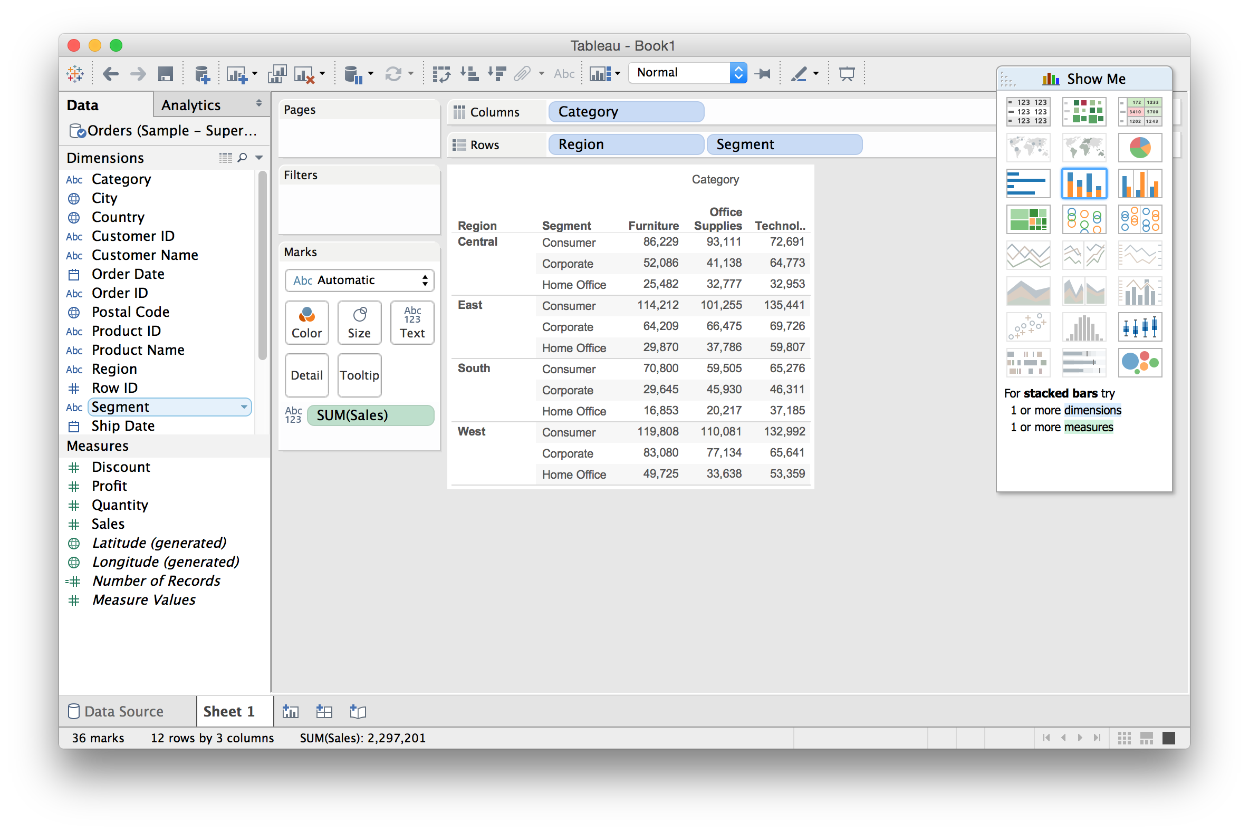
Further refine by subdividing

Slide 35
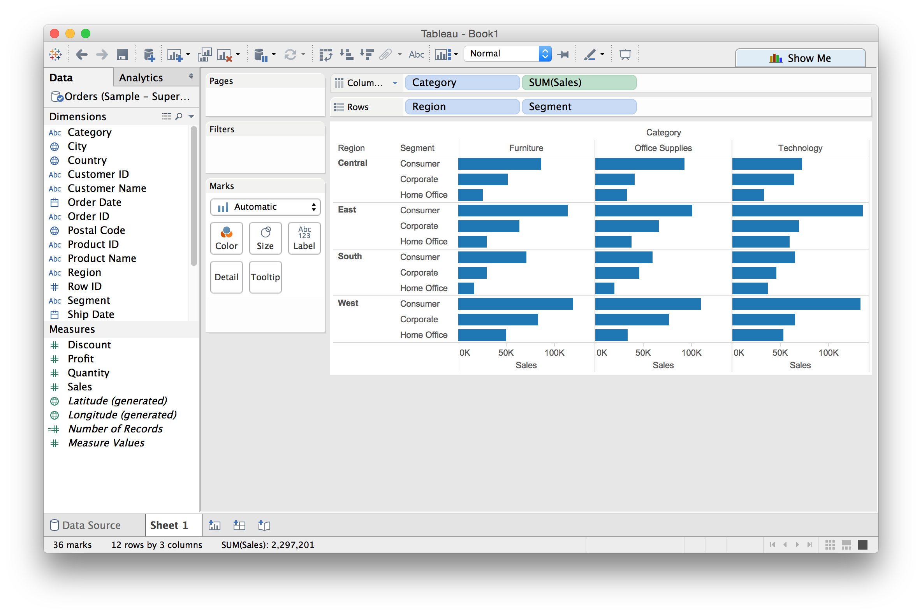
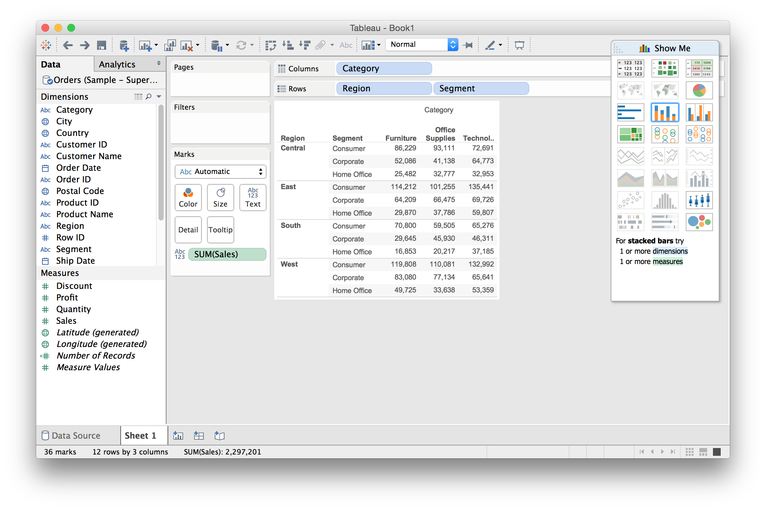
From Text Table to Bar Chart

Slide 36
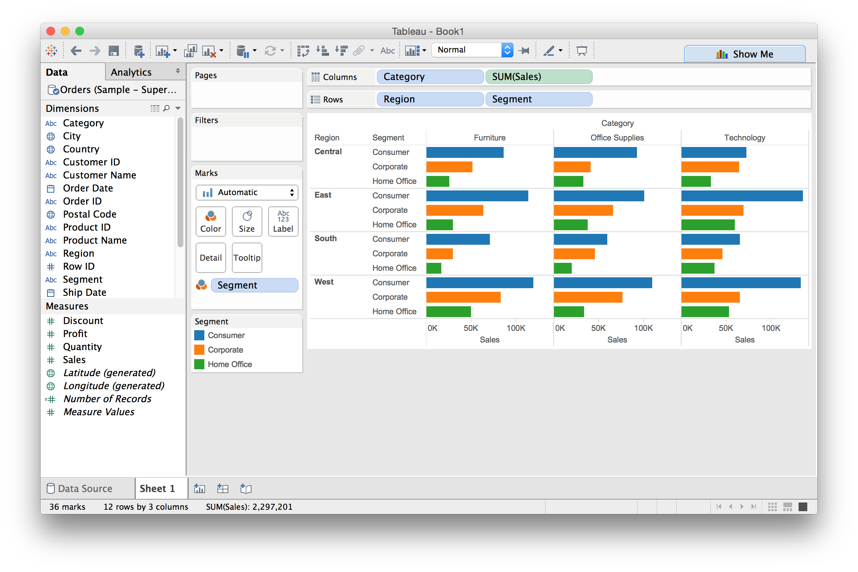
Dual encoding using color

Slide 37
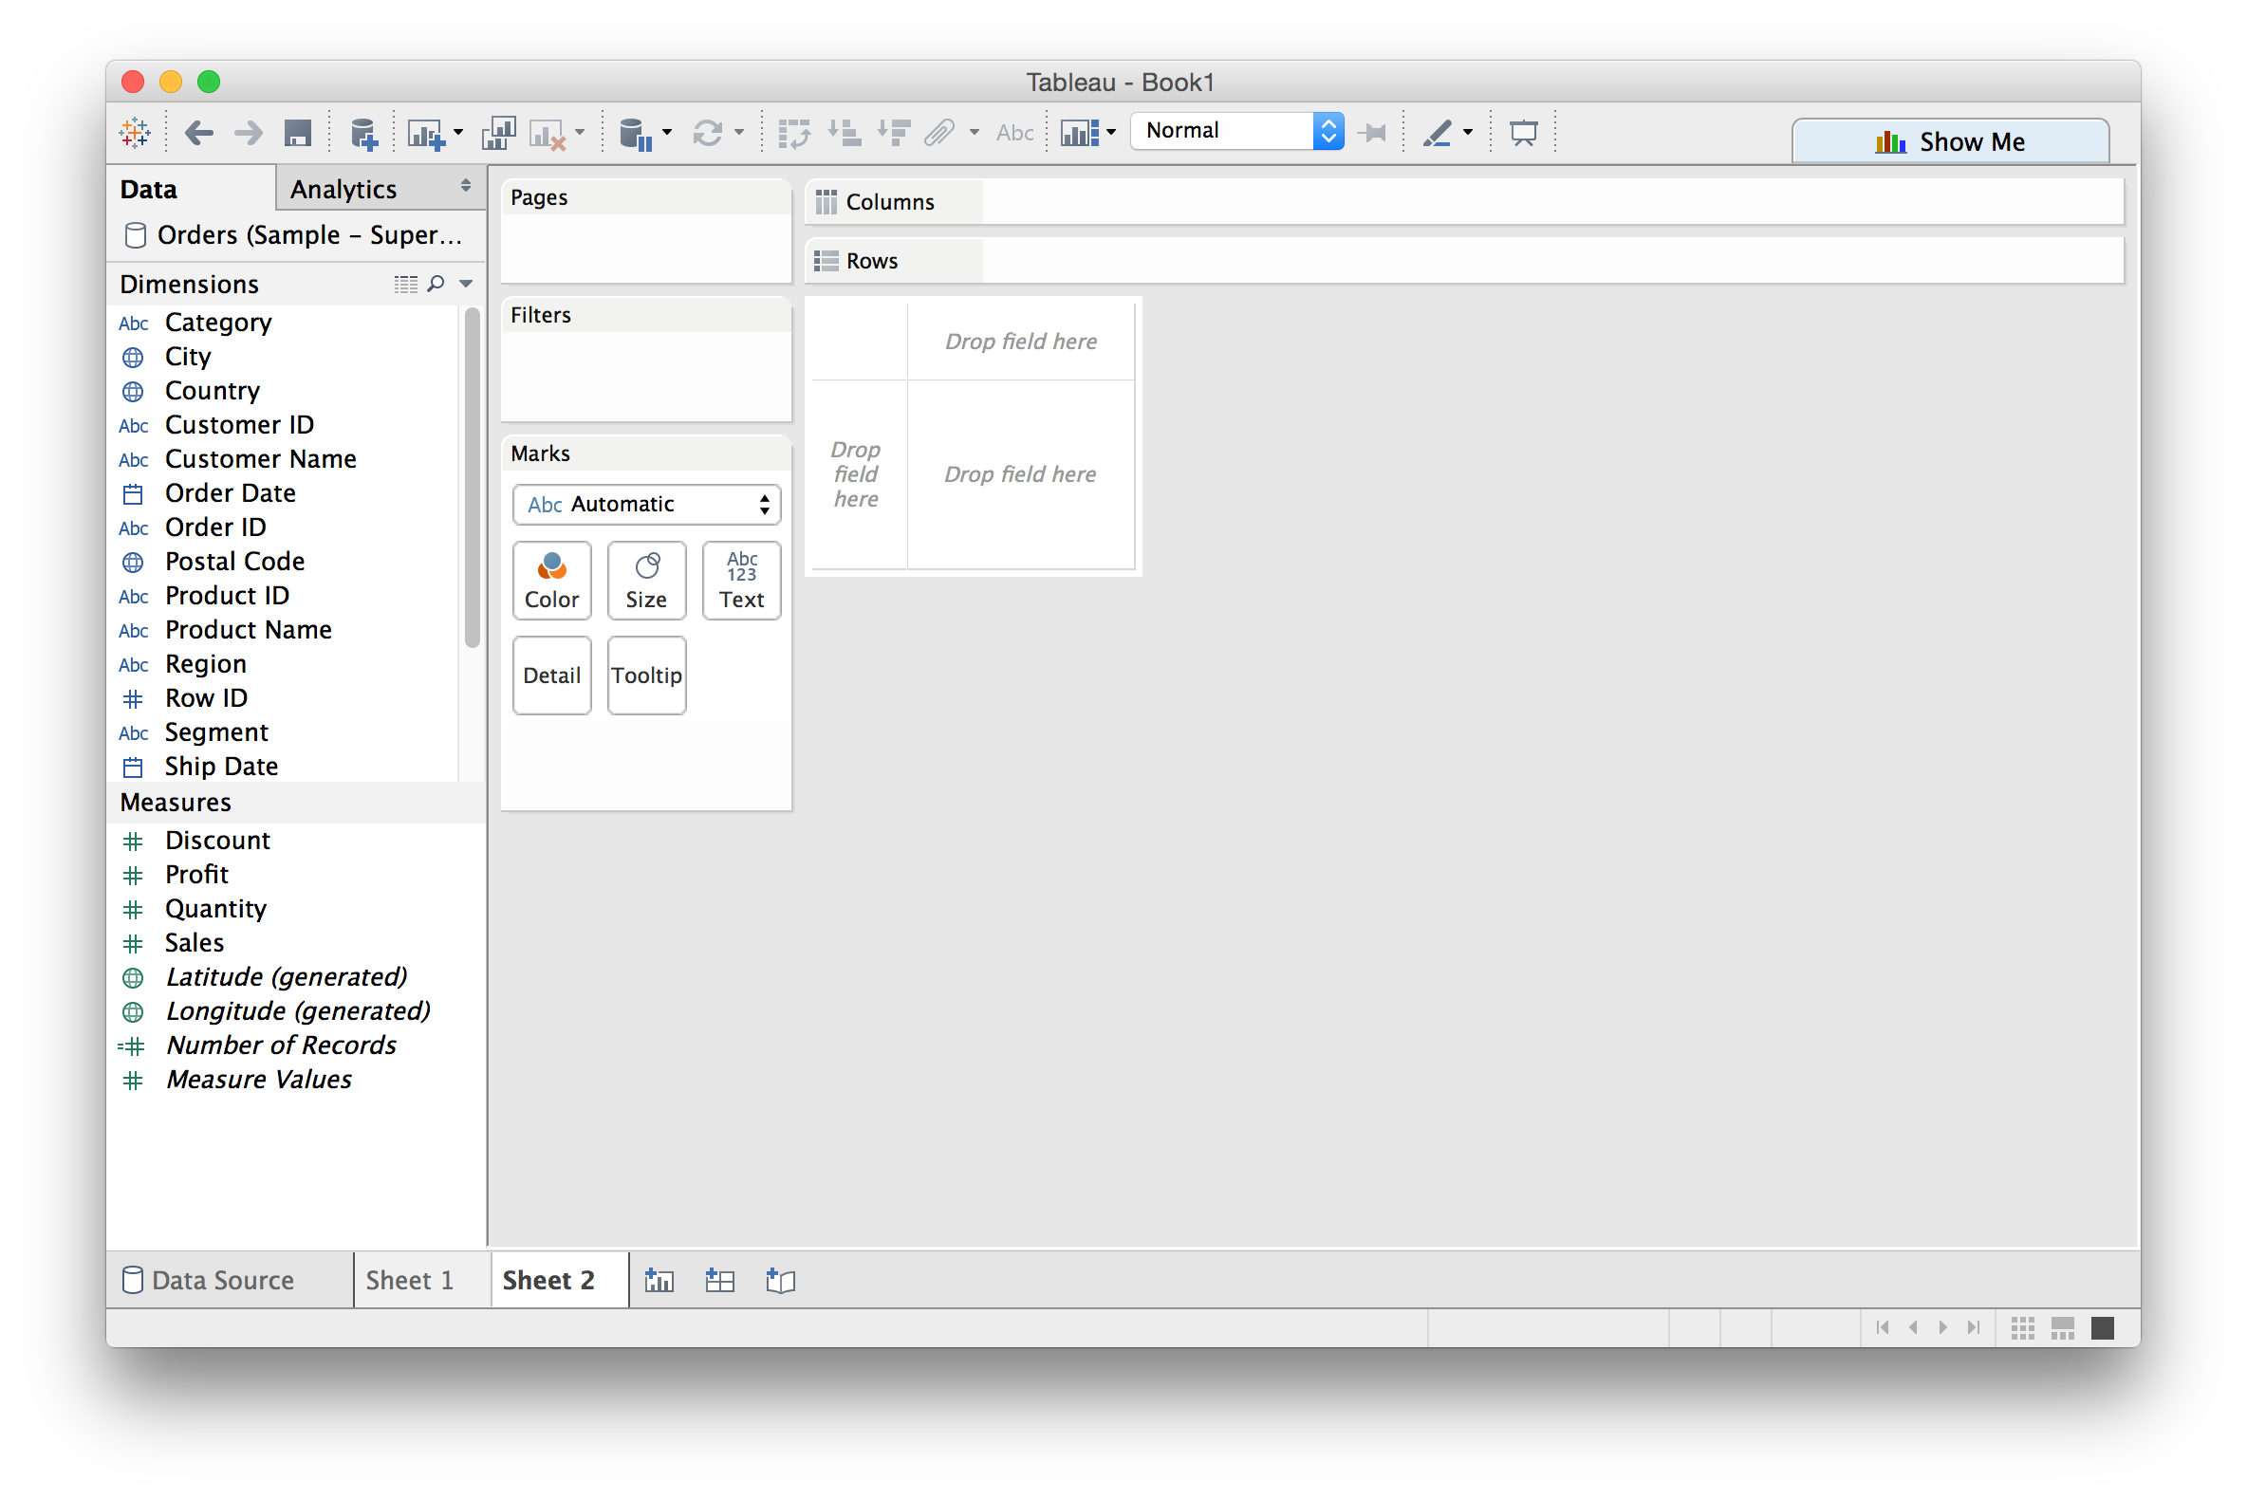

Creating a new sheet

Slide 38
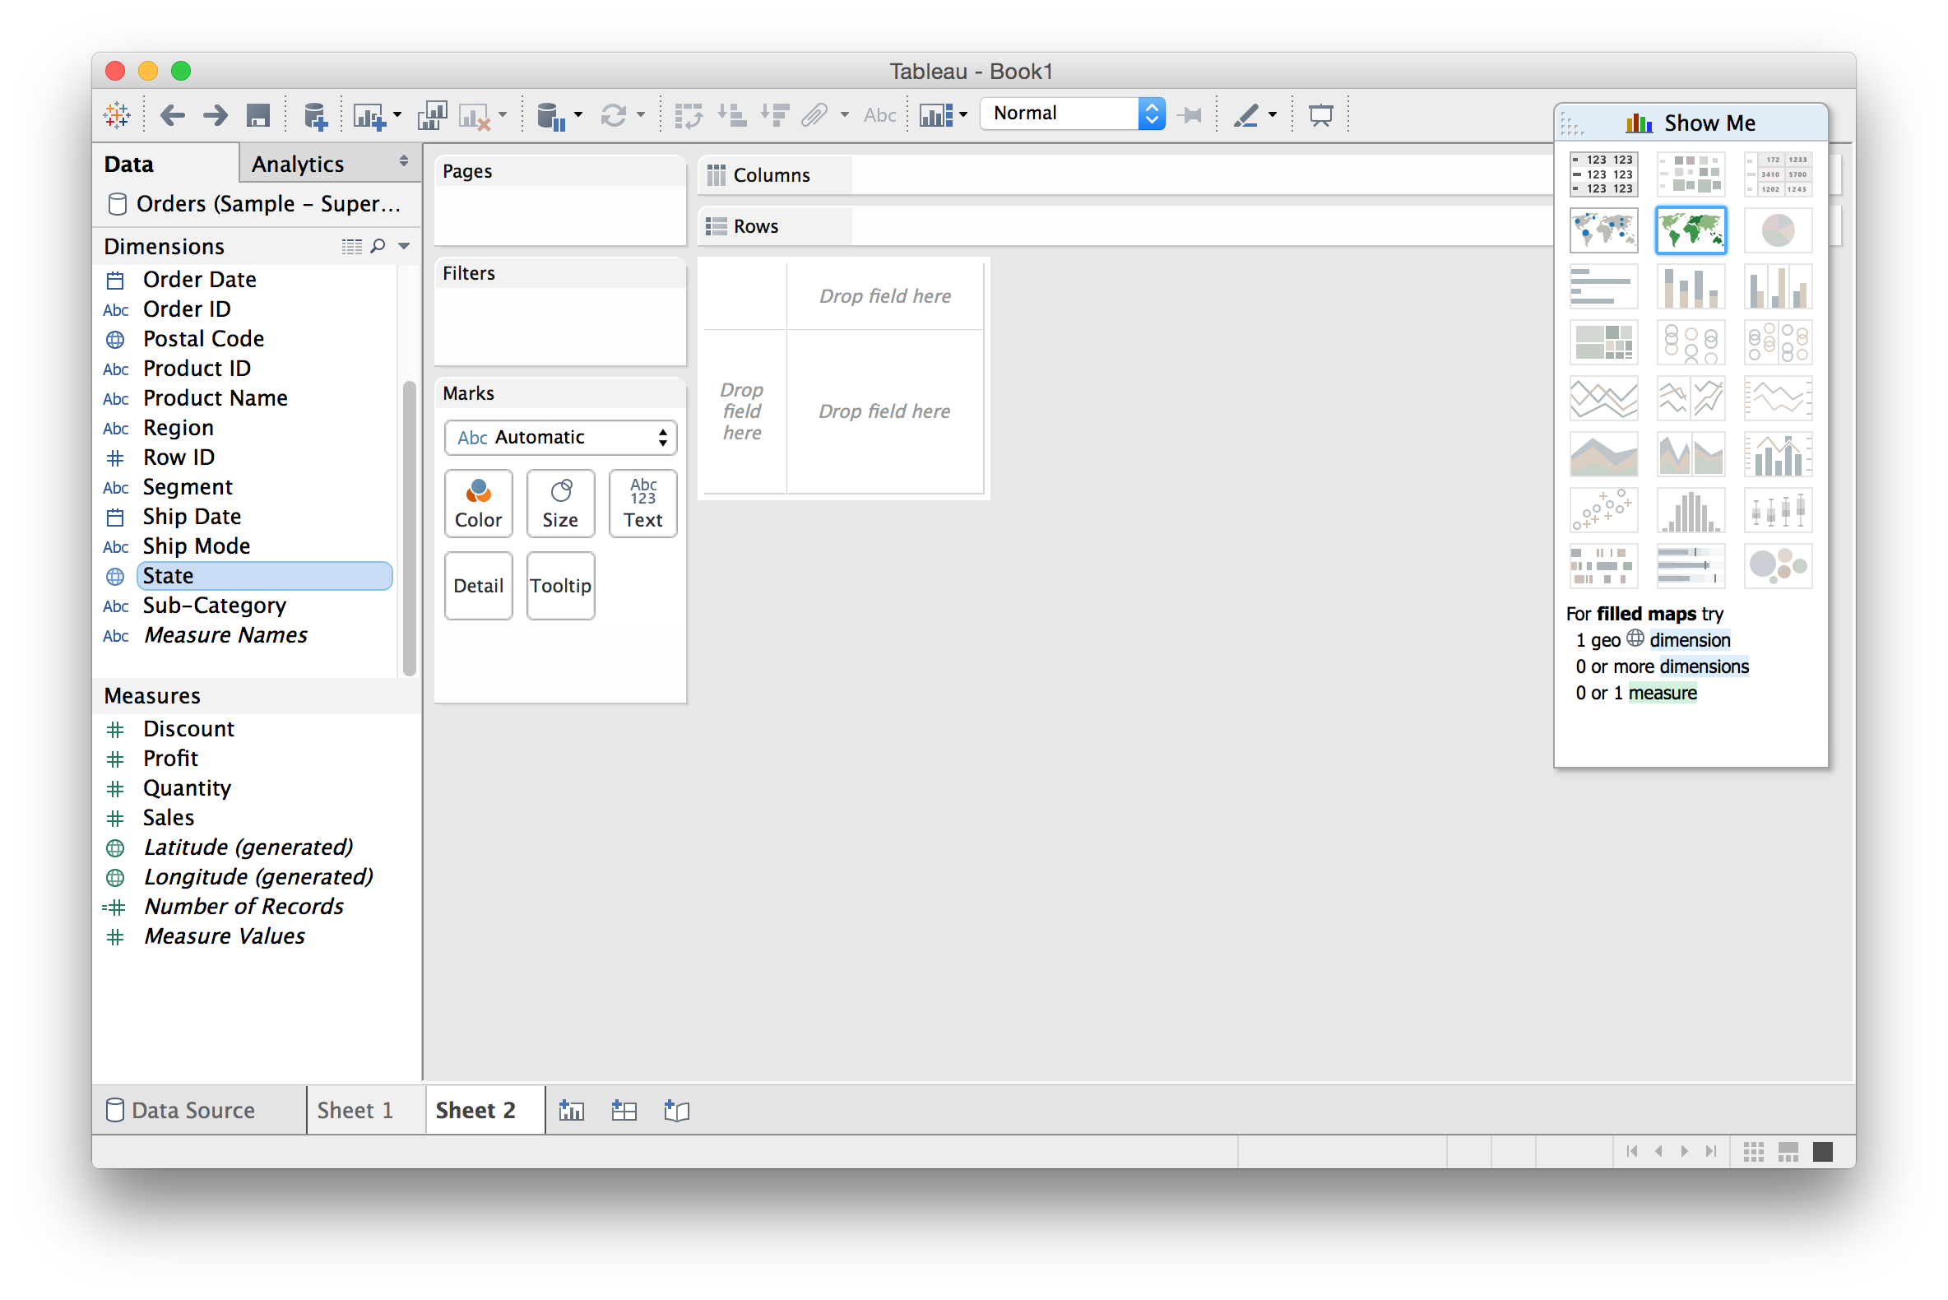
Using “Show Me”: a VIS recommender

Slide 39
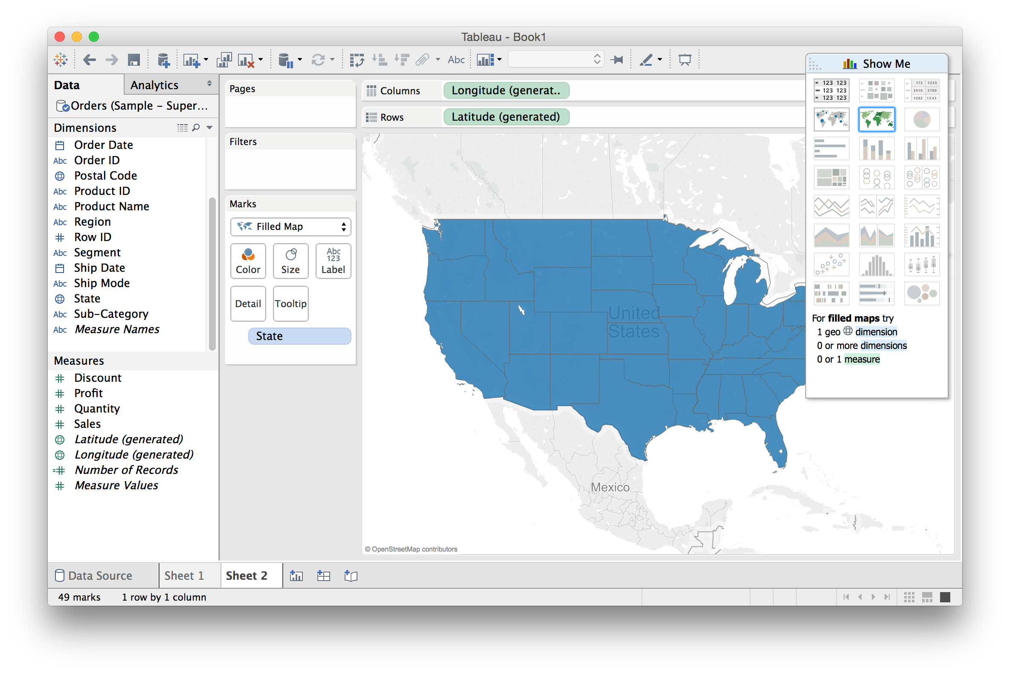
Using “Show Me”: a VIS recommender

Slide 40
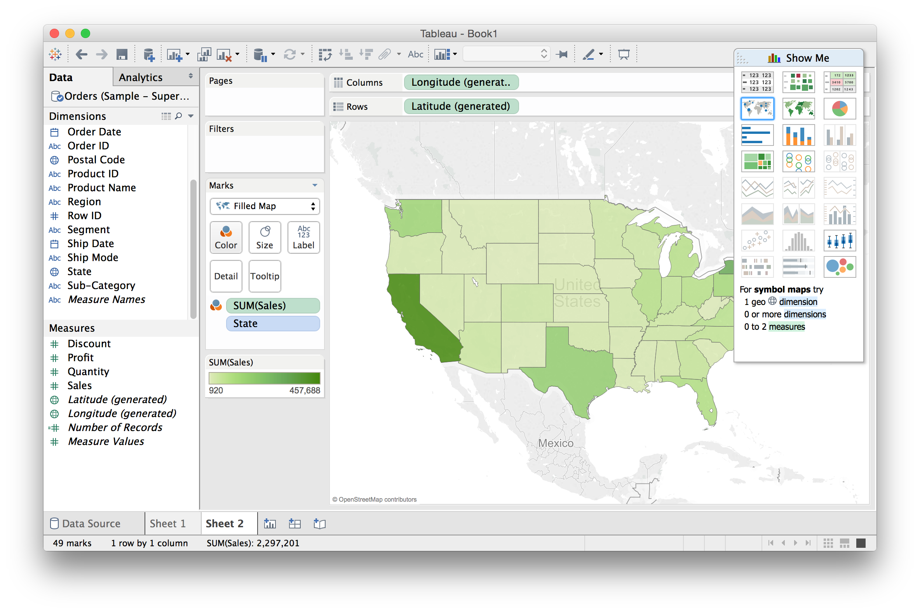
Using “Show Me”: a VIS recommender

Slide 41
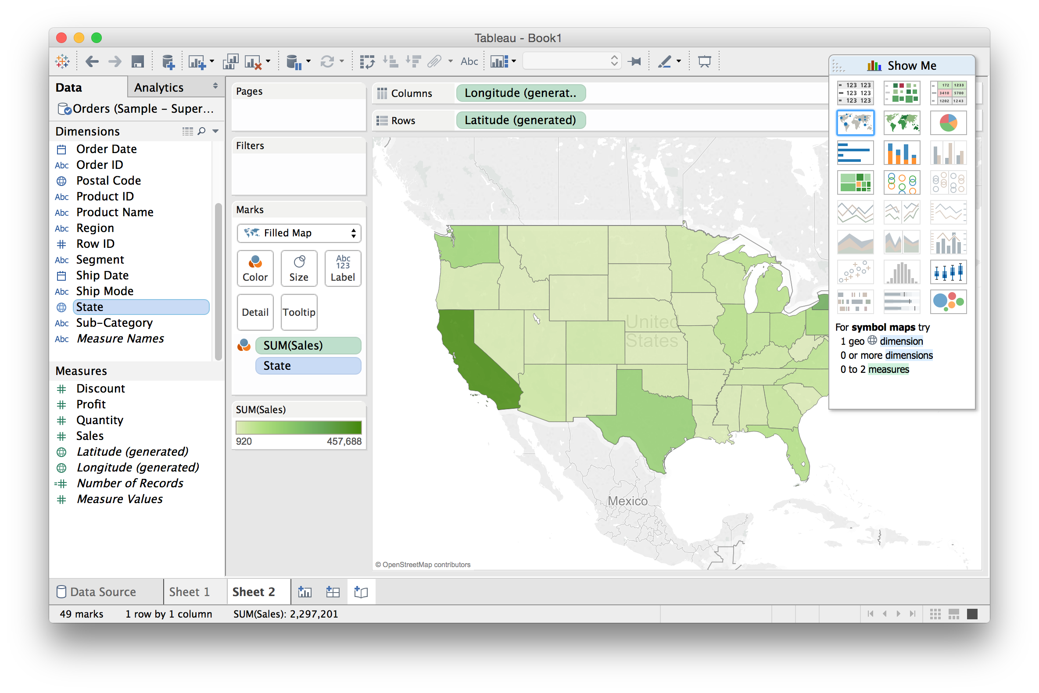
Building Stories from Multiple Views

Slide 42
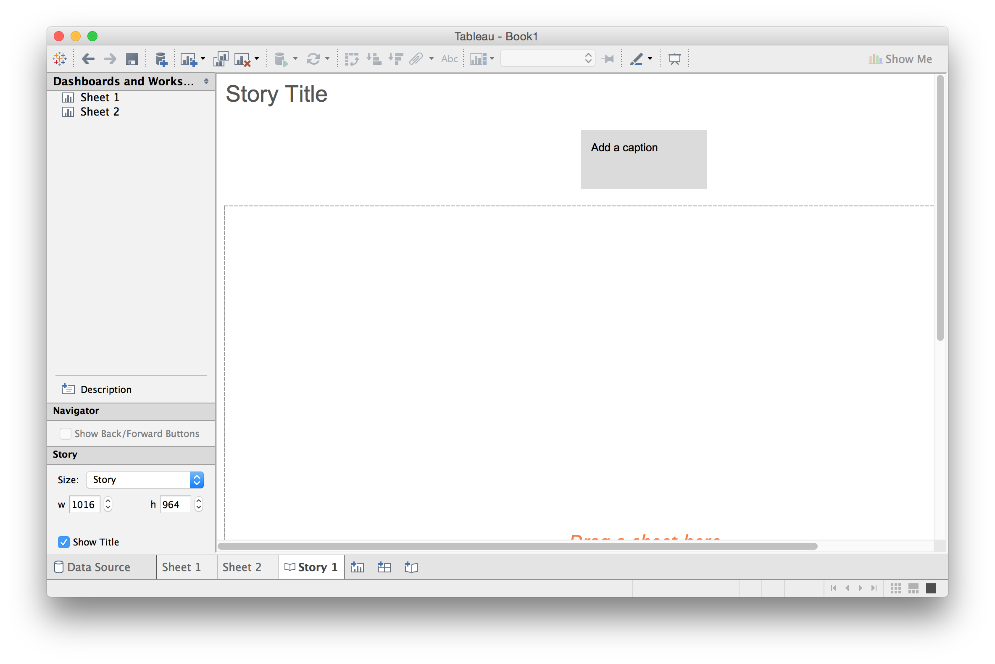
Building Stories from Multiple Views

Slide 43
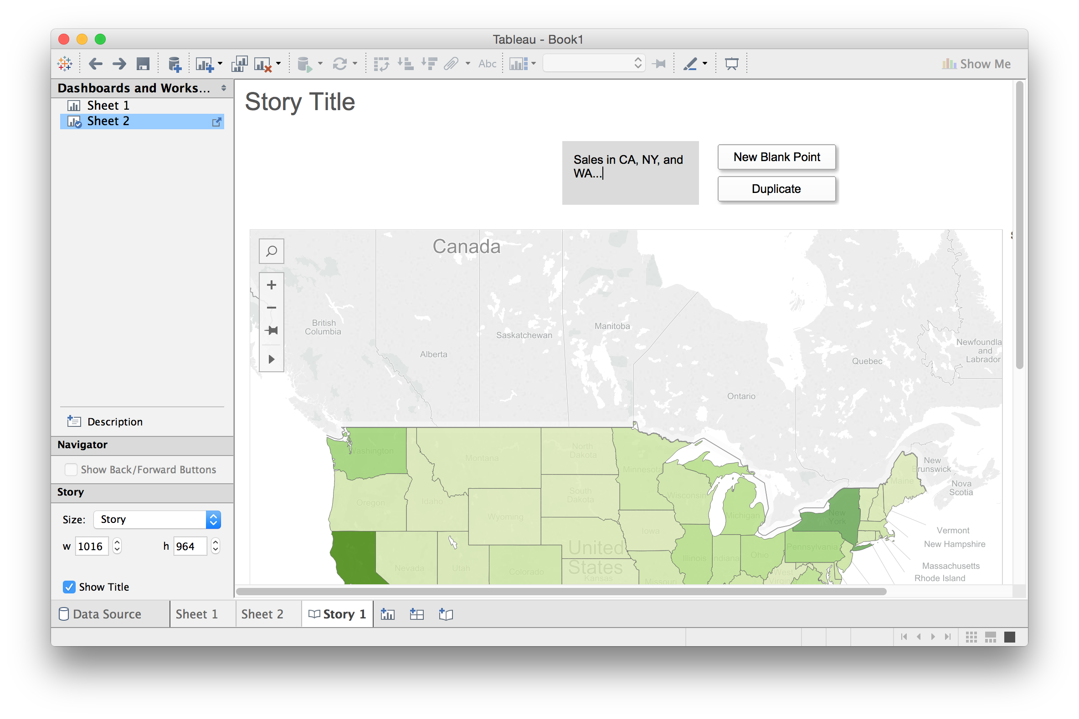
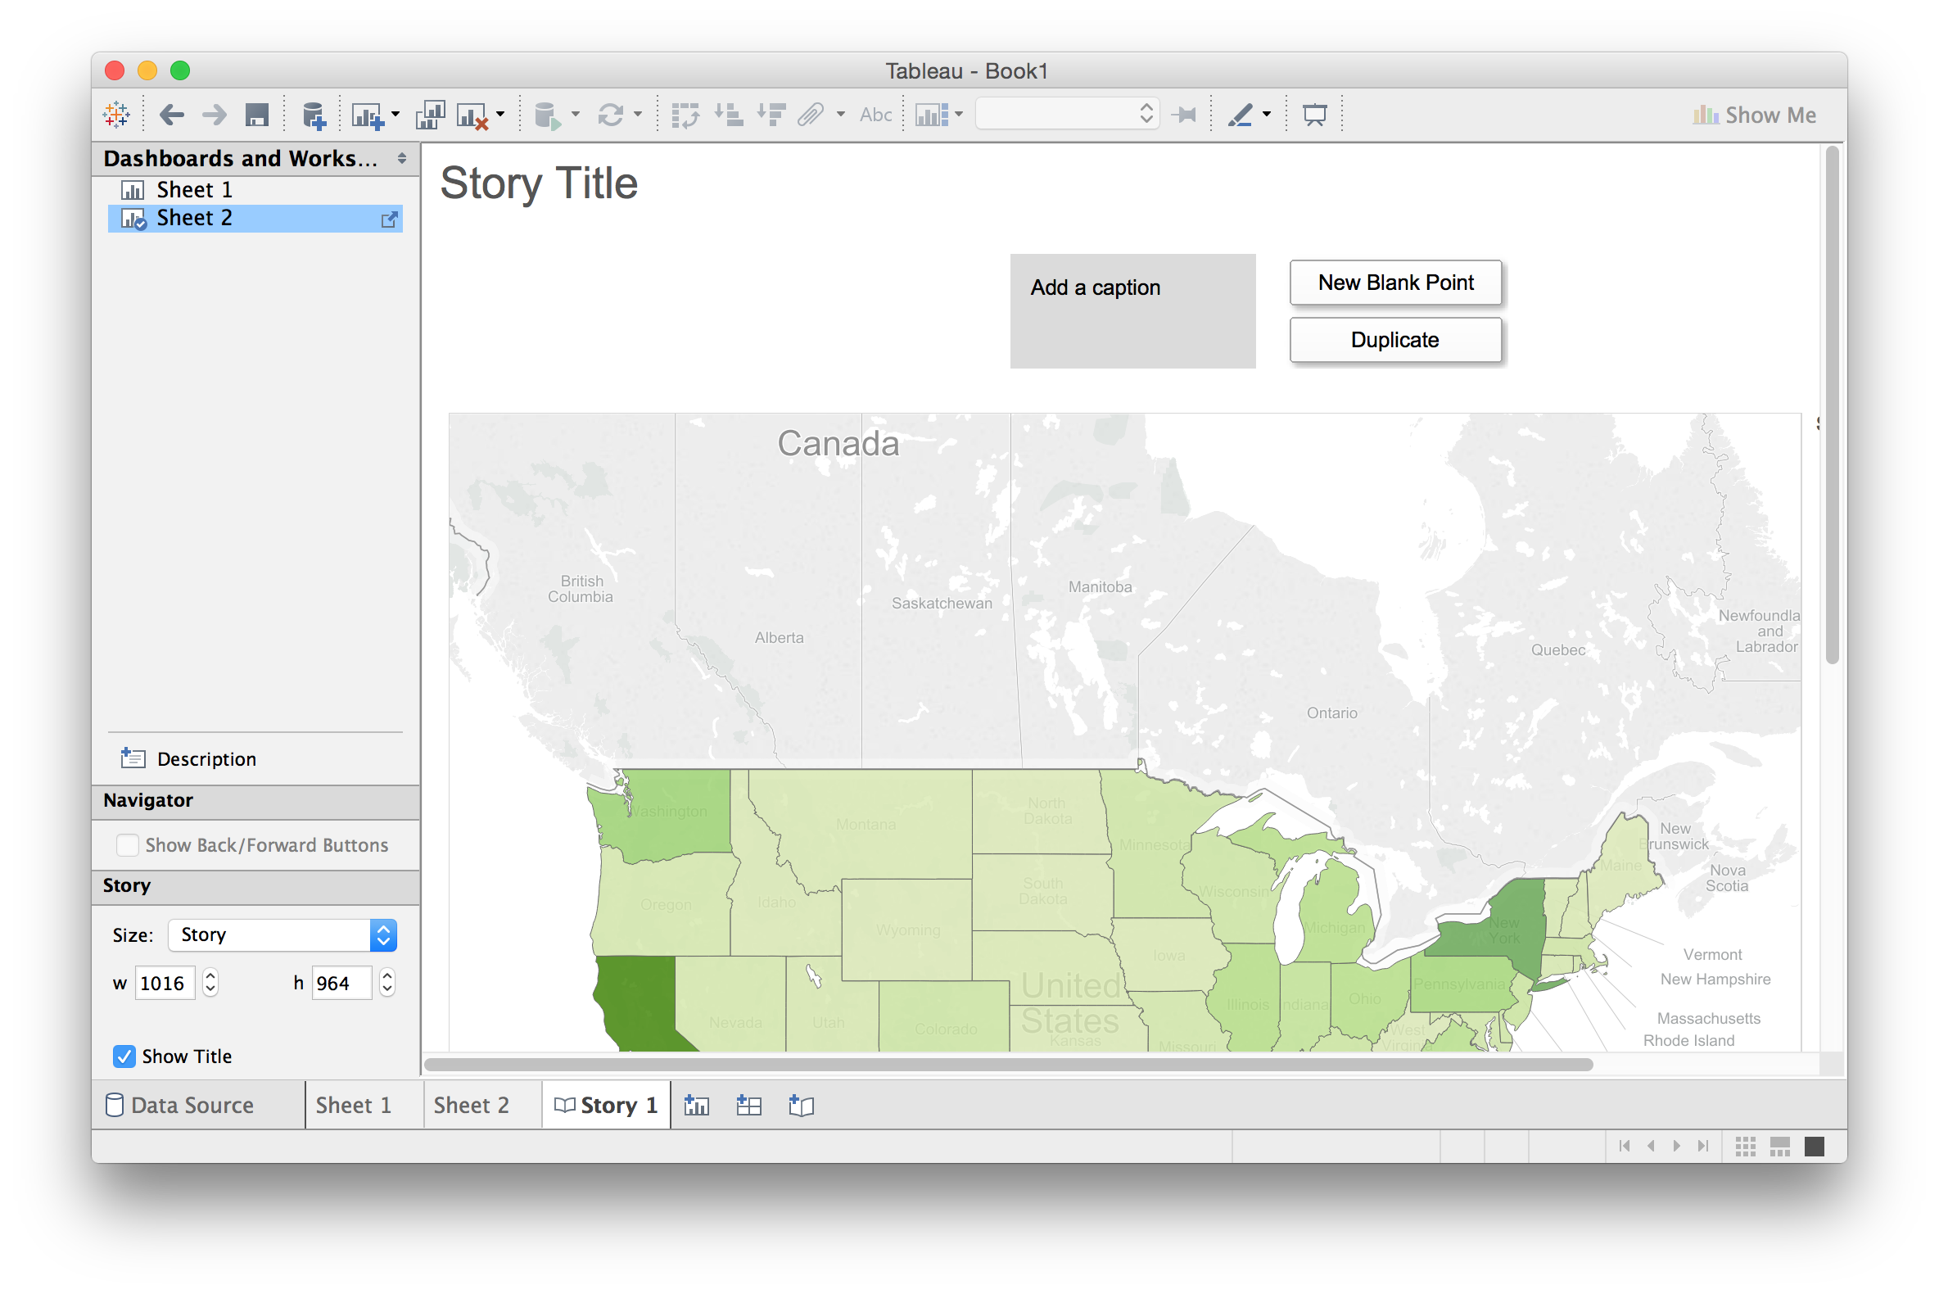
Building Stories from Multiple Views

Slide 44
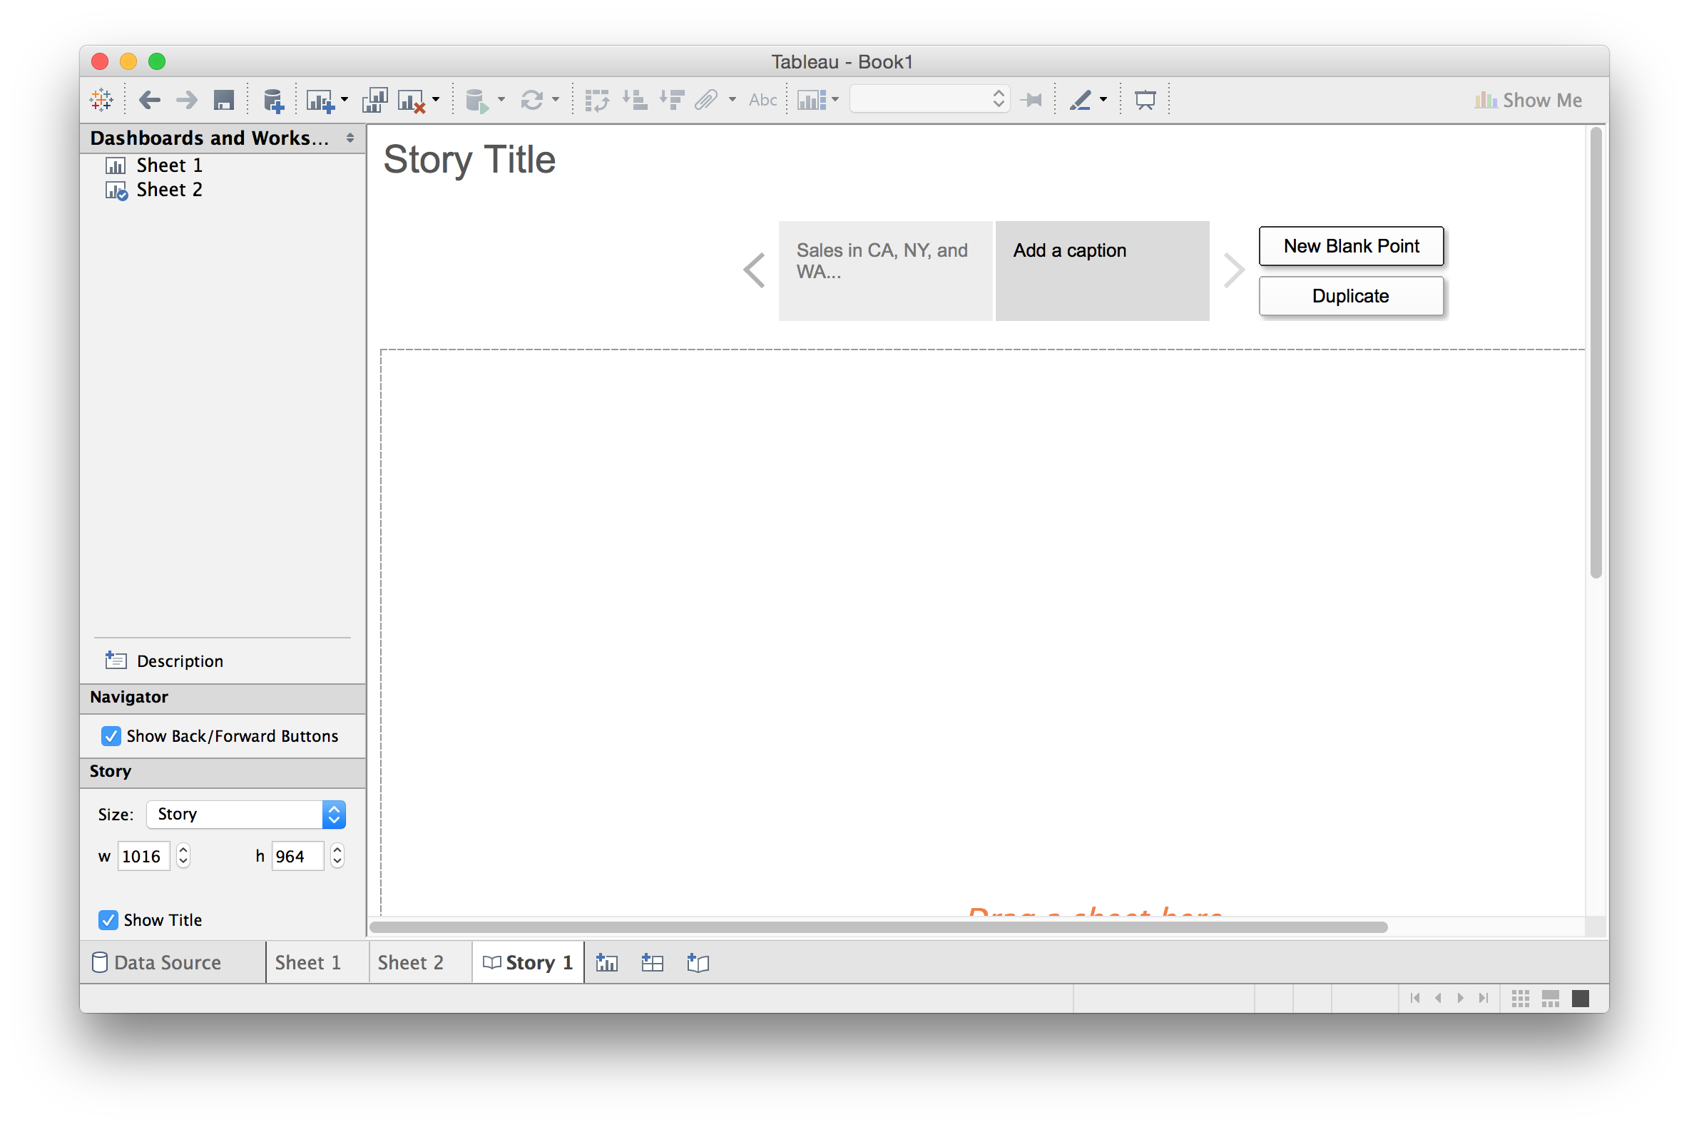
Building Stories from Multiple Views

Slide 45
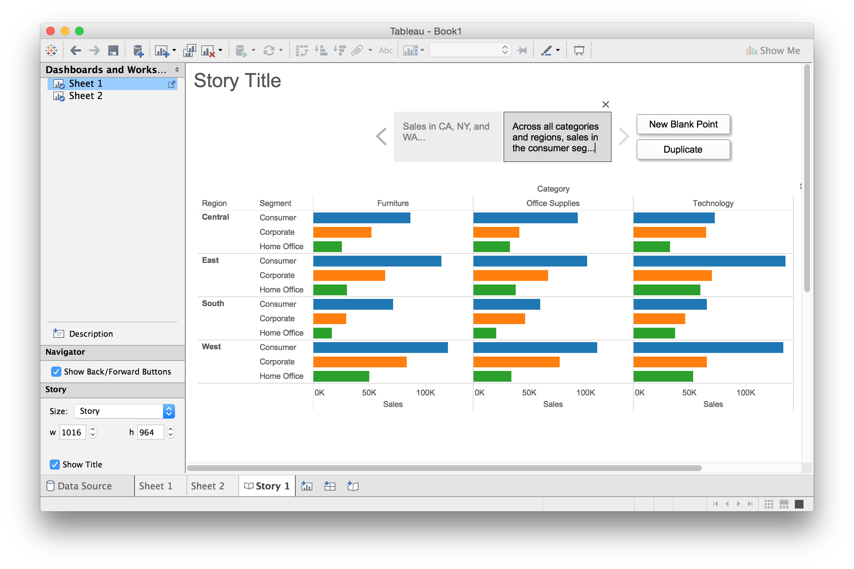

Building Stories from Multiple Views

Slide 46
Questions?

Slide 47
Lab pt. 2: Exploring Other Datasets

Slide 48

Lab pt. 2: Exploring Other Datasets
goo.gl/kcbqfc

Slide 49
Discussion
What are some of Tableau’s strengths? Weaknesses?
Was there anything you couldn’t figure out?

Slide 50

Coming Up
Next class: Visualization Fundamentals pt. 2
Assignment 1 will be posted Tuesday, and will be due the following Thursday (Sept. 29th)
Next Thursday: first trip to SCMA! More details Tuesday

